Slide 1
Exploring the Metabolic–Immune Role of DGAT1 in Glioblastoma

Slide 2
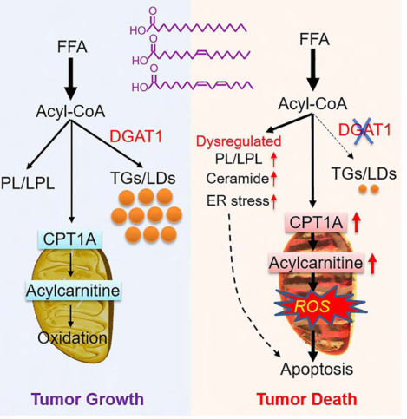
DGAT1 Active (left panel)
Free fatty acids (FFAs) esterified → triacylglycerols (TGs)
Stored in lipid droplets (LDs)
Prevents lipotoxicity, ER stress, ROS buildup
Supports tumor survival & growth
With DGAT1 inhibited (right):
FFAs diverted to mitochondrial β-oxidation (via CPT1A)
Lipid imbalance + ceramide accumulation
↑ ER stress, ↑ ROS, cytochrome c release → apoptosis
Suppresses tumor growth
Cheng X, Geng F, Pan M, Wu X, Zhong Y, Wang C, Tian Z, Cheng C, Zhang R, Puduvalli V, Horbinski C, Mo X, Han X, Chakravarti A, Guo D. Targeting DGAT1 Ameliorates Glioblastoma by Increasing Fat Catabolism and Oxidative Stress. Cell Metab. 2020 Aug 4;32(2):229-242.e8. doi: 10.1016/j.cmet.2020.06.002. Epub 2020 Jun 18. PMID: 32559414; PMCID: PMC7415721.
20250930

Slide 3
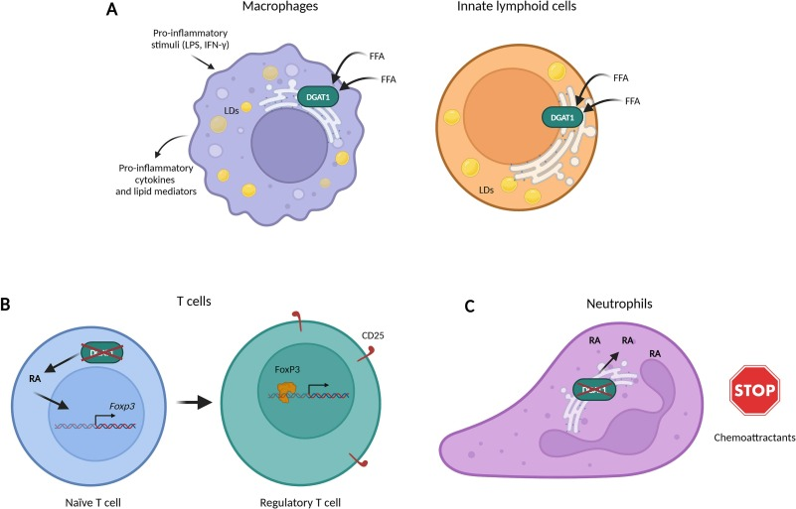
Immunomodulatory activity of DGAT1
A. Macrophages & Innate Lymphoid Cells
DGAT1 → lipid droplet (LD) formation from FFAs
Fuels production of cytokines & lipid mediators
👉 Effect: Pro-inflammatory / immune-activating
Source: Oleszycka et al., Life Sci 2024/25 (review); Wu et al., Cancer Immunol Res 2019 (colon cancer TAMs)
B. T cells (Treg differentiation)
DGAT1–retinoic acid (RA) axis → FoxP3 induction, Treg expansion (CD25+, FoxP3+)
👉 Effect: Immunosuppressive (expands Tregs, dampens effector immunity)
Source: Zaiss/Wang et al., PNAS 2019 (autoimmune disease model, not cancer)
C. Neutrophils DGAT1 deficiency → ↑ RA accumulation → impaired chemotaxis toward chemoattractants
Normal DGAT1 = maintains neutrophil migration capacity
👉 Effect: DGAT1 loss = suppressive (↓ neutrophil infiltration)
Source: Uchańska et al., Inflamm Res 2024 (psoriasis model)
Oleszycka, E., Kwiecień, K., Grygier, B., Cichy, J., & Kwiecińska, P. (2025). The many faces of DGAT1. Life Sciences, 362, 123322. https://doi.org/10.1016/j.lfs.2024.123322
20250930

Slide 4
Background
DGAT1: key lipid droplet enzyme, connects fatty acid metabolism to immunity
Immunology:
Macrophages/ILCs → pro-inflammatory (LD-driven cytokines)
Tregs → immunosuppressive (FoxP3+ CD25+)
Neutrophils → DGAT1 needed for migration
Gap in Knowledge
In GBM, DGAT1 is upregulated in tumor cells (Guo Lab, Cell Metab 2020)
But: immune consequences remain unexplored
No integrated view of tumor metabolism ↔ immune infiltration
My Project Rationale
Test if DGAT1 shapes GBM immune landscape
Multi-omics strategy: TCGA/CGGA RNA → CPTAC protein → immune marker mapping
Goal: determine if DGAT1-high tumors are “immune cold” or “immune suppressive”

Slide 5
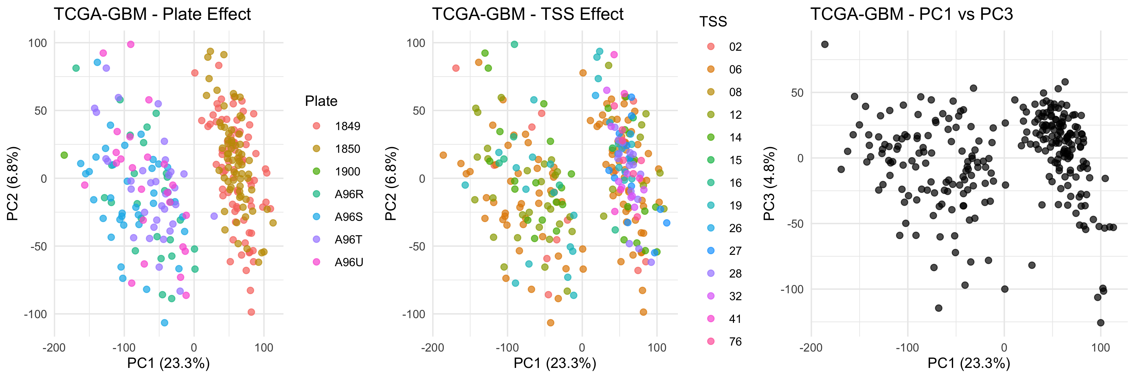
20250930
TCGA-GBM FIXED DOWNLOAD & PREPROCESSING
Processing date: 2025-09-30
TCGAbiolinks version: 2.25.3
FINAL COHORT:
Patients: 268
Genes: 23510
SURVIVAL DATA:
Events: 228 (85.1%)
Censored: 40 (14.9%)
Median OS (events): 1.06 years
Median follow-up (censored): 0.66 years
QC CHECKS:
Event rate: 70-85% expected | 85.1% observed | FAIL
Median OS: 0.8-2.0 y expected | 1.06 y observed | PASS
VALIDATION GENES:
EGFR: p=0.0033
TP53: p=0.0773
PTEN: p=0.0219
IDH1: p=0.0264
Significant: 3 / 4
DATA PROVENANCE:
Source: TCGA GDC Data Portal
Project: TCGA-GBM
Workflow: STAR - Counts

Slide 6
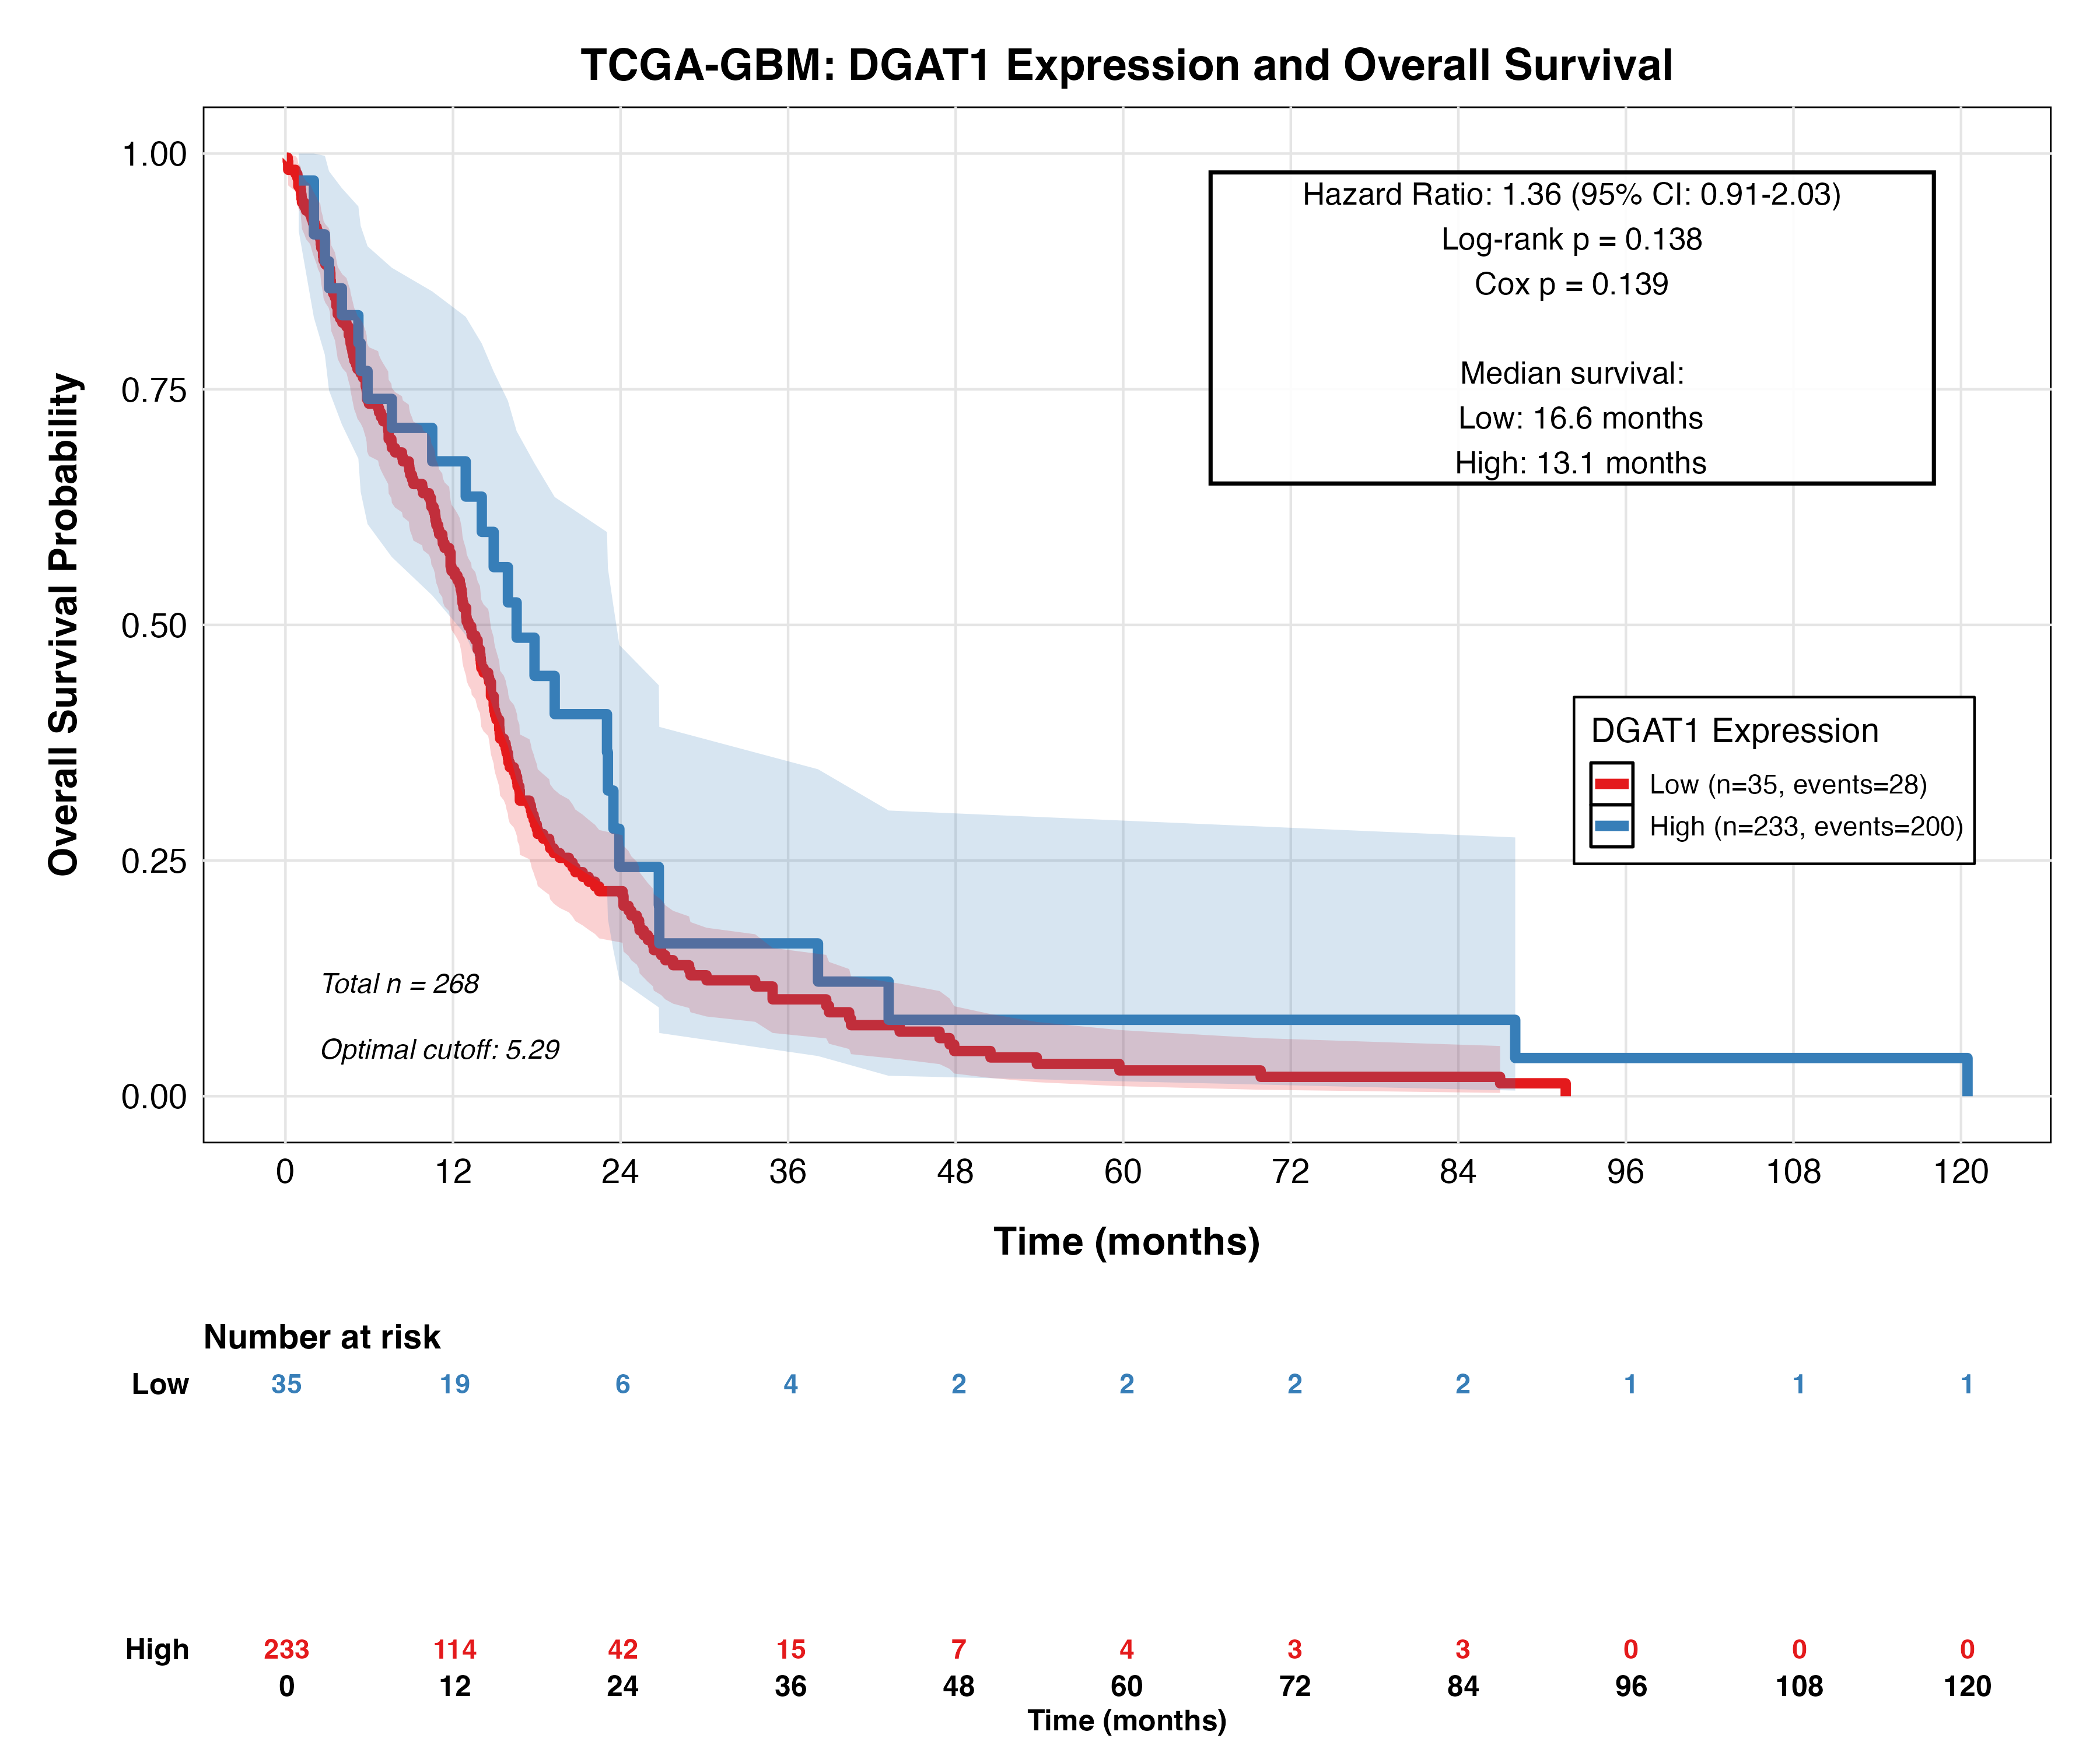
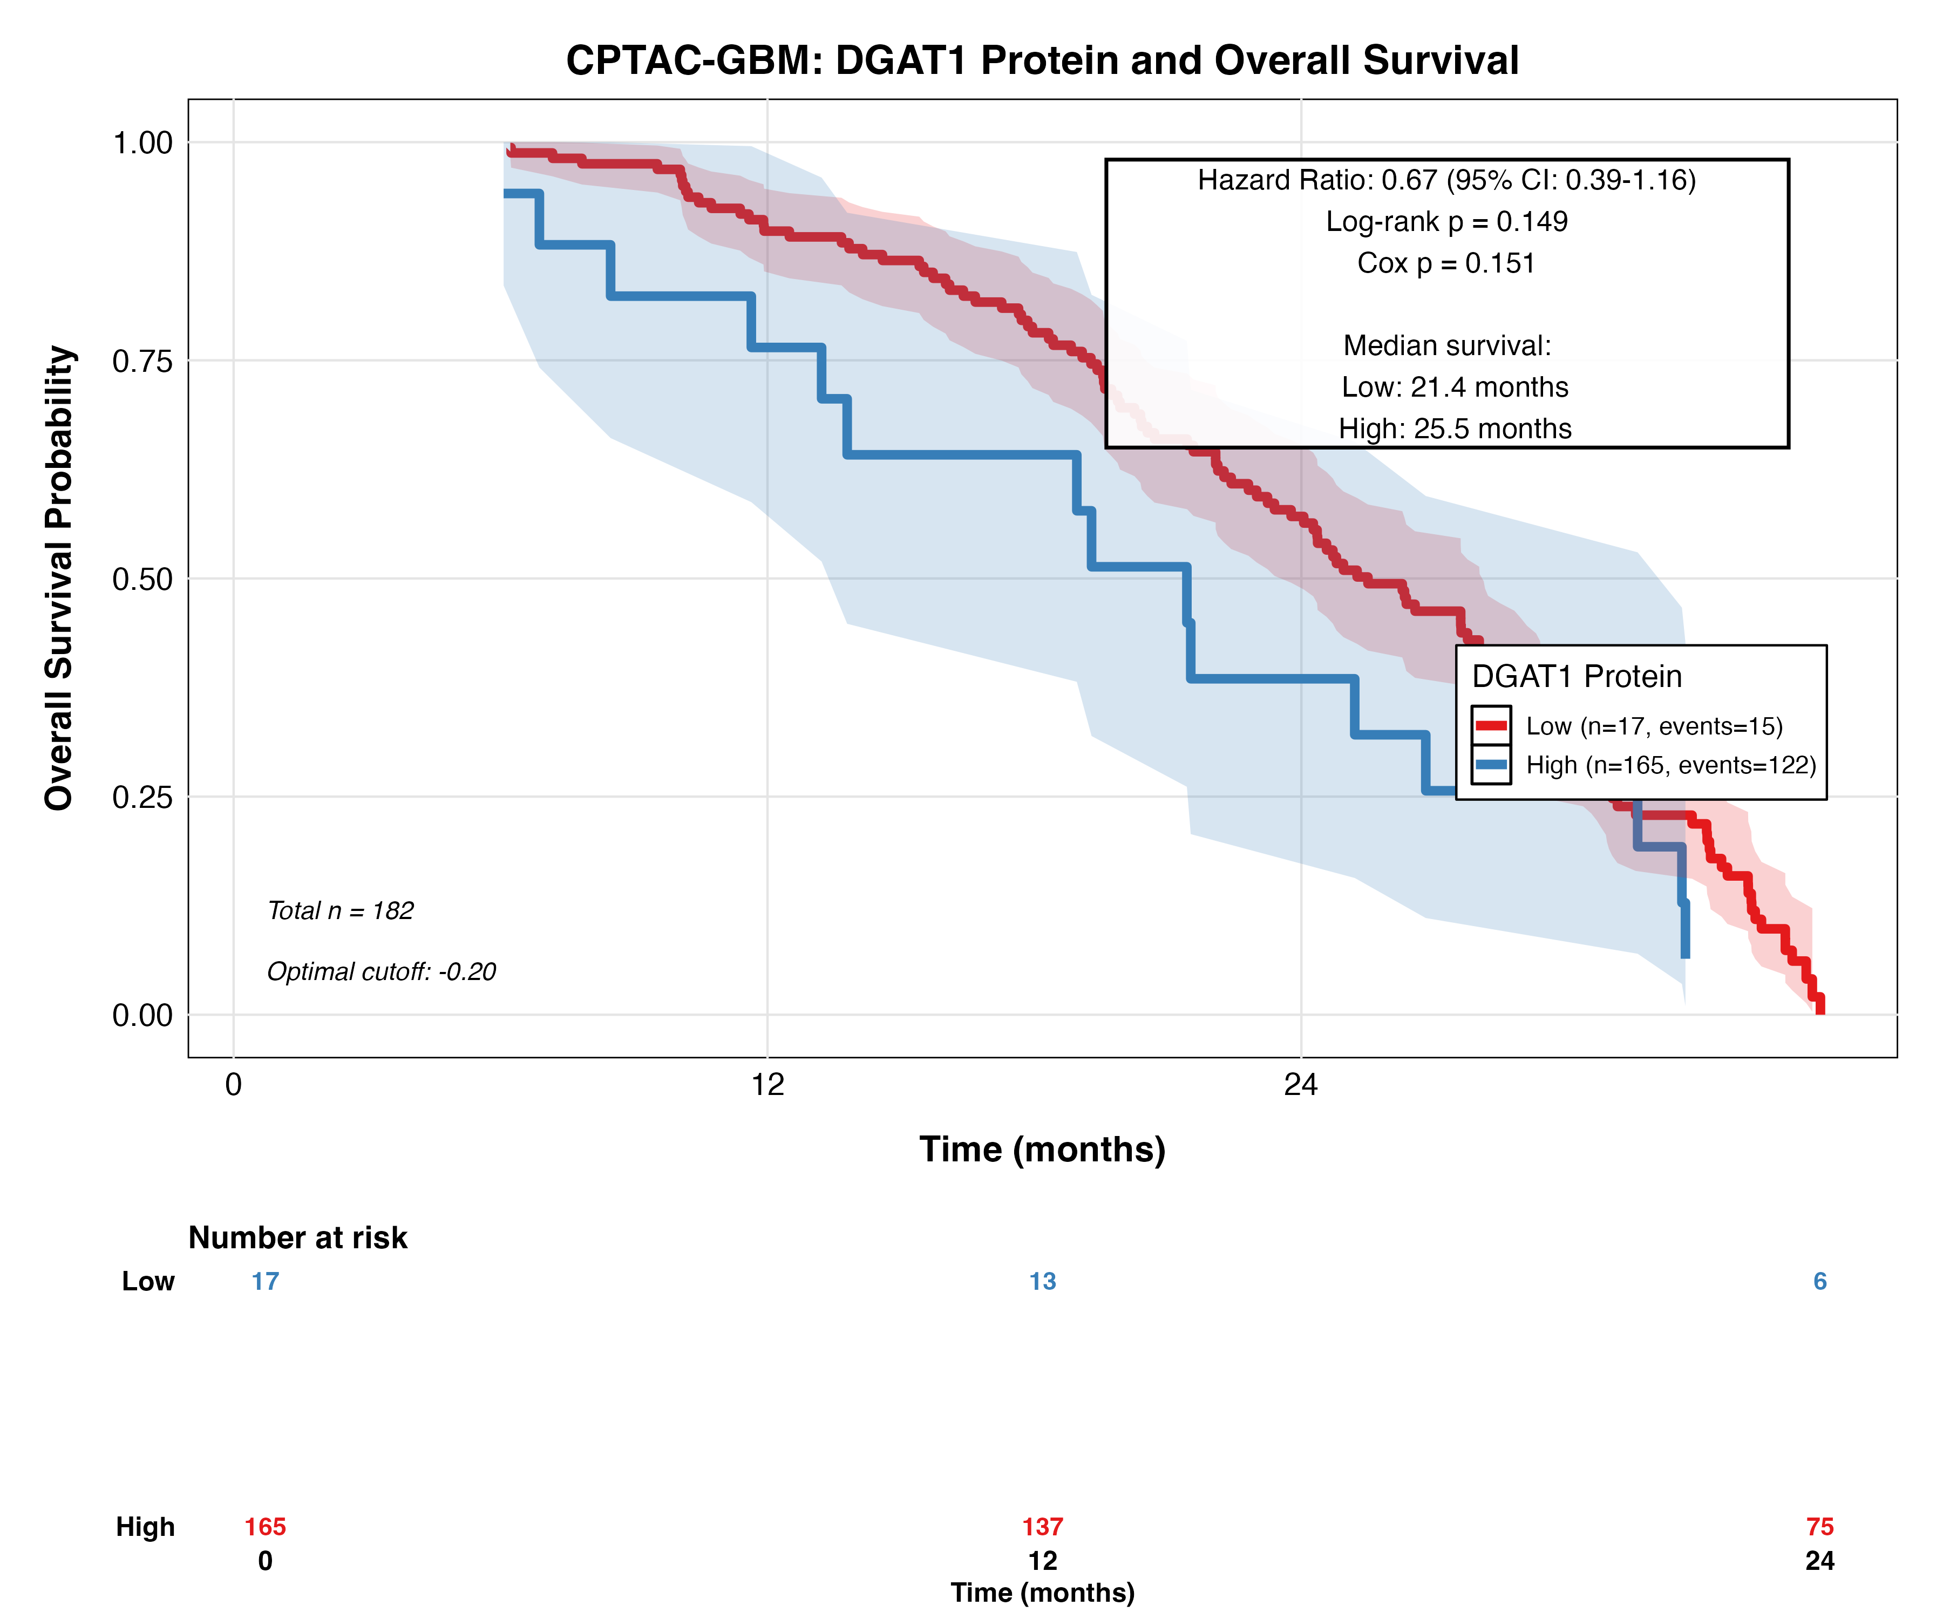
20250930

Slide 7
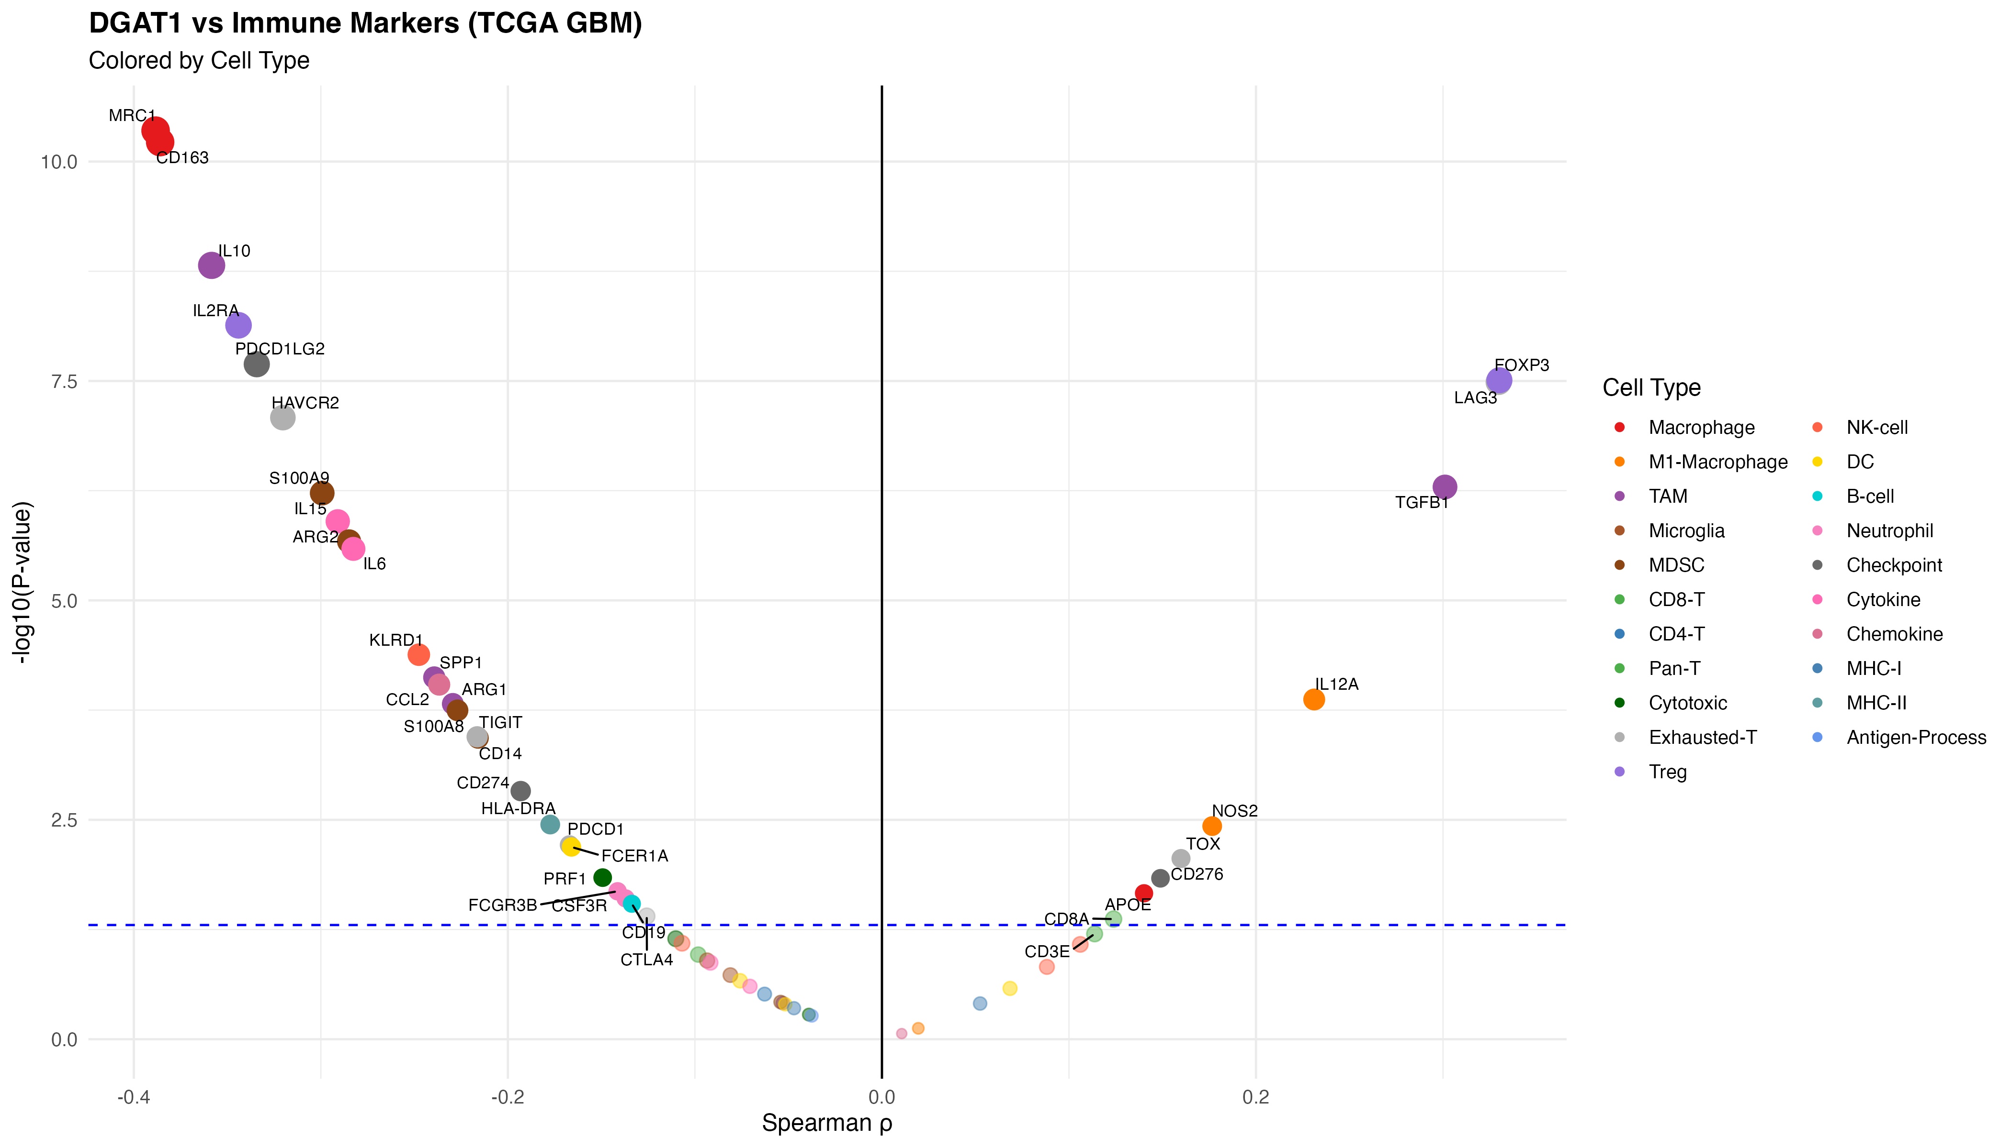
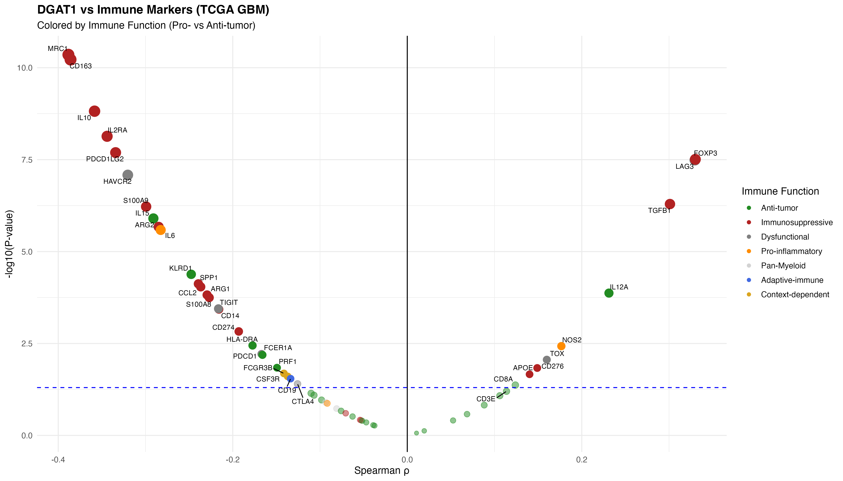
20250929
Key Points:
57 immune markers analyzed across 268 GBM samples
Strong negative associations with M2/TAM markers (left side):
CD163, MRC1 (ρ ≈ -0.39, FDR < 0.001) - M2 macrophages
IL10 (ρ = -0.36, FDR < 0.001) - Immunosuppressive cytokine
S100A9 (ρ = -0.30, FDR < 0.001) - MDSCs
Positive associations with Treg markers (right side):
FOXP3 (ρ = +0.33, FDR < 0.001)
LAG3 (ρ = +0.33, FDR < 0.001) - Exhaustion marker
Key Points:
Immunosuppressive markers (red): Negative correlations (17/20 significant)
M2, TAM, MDSC, checkpoint markers reduced in DGAT1-high
Anti-tumor markers (green): Limited associations (6/23 significant)
Weak negative trends for CD8 T cell and NK markers
Dysfunctional markers (gray): Mixed patterns (5/6 significant)
Complex T cell exhaustion signatures

Slide 8
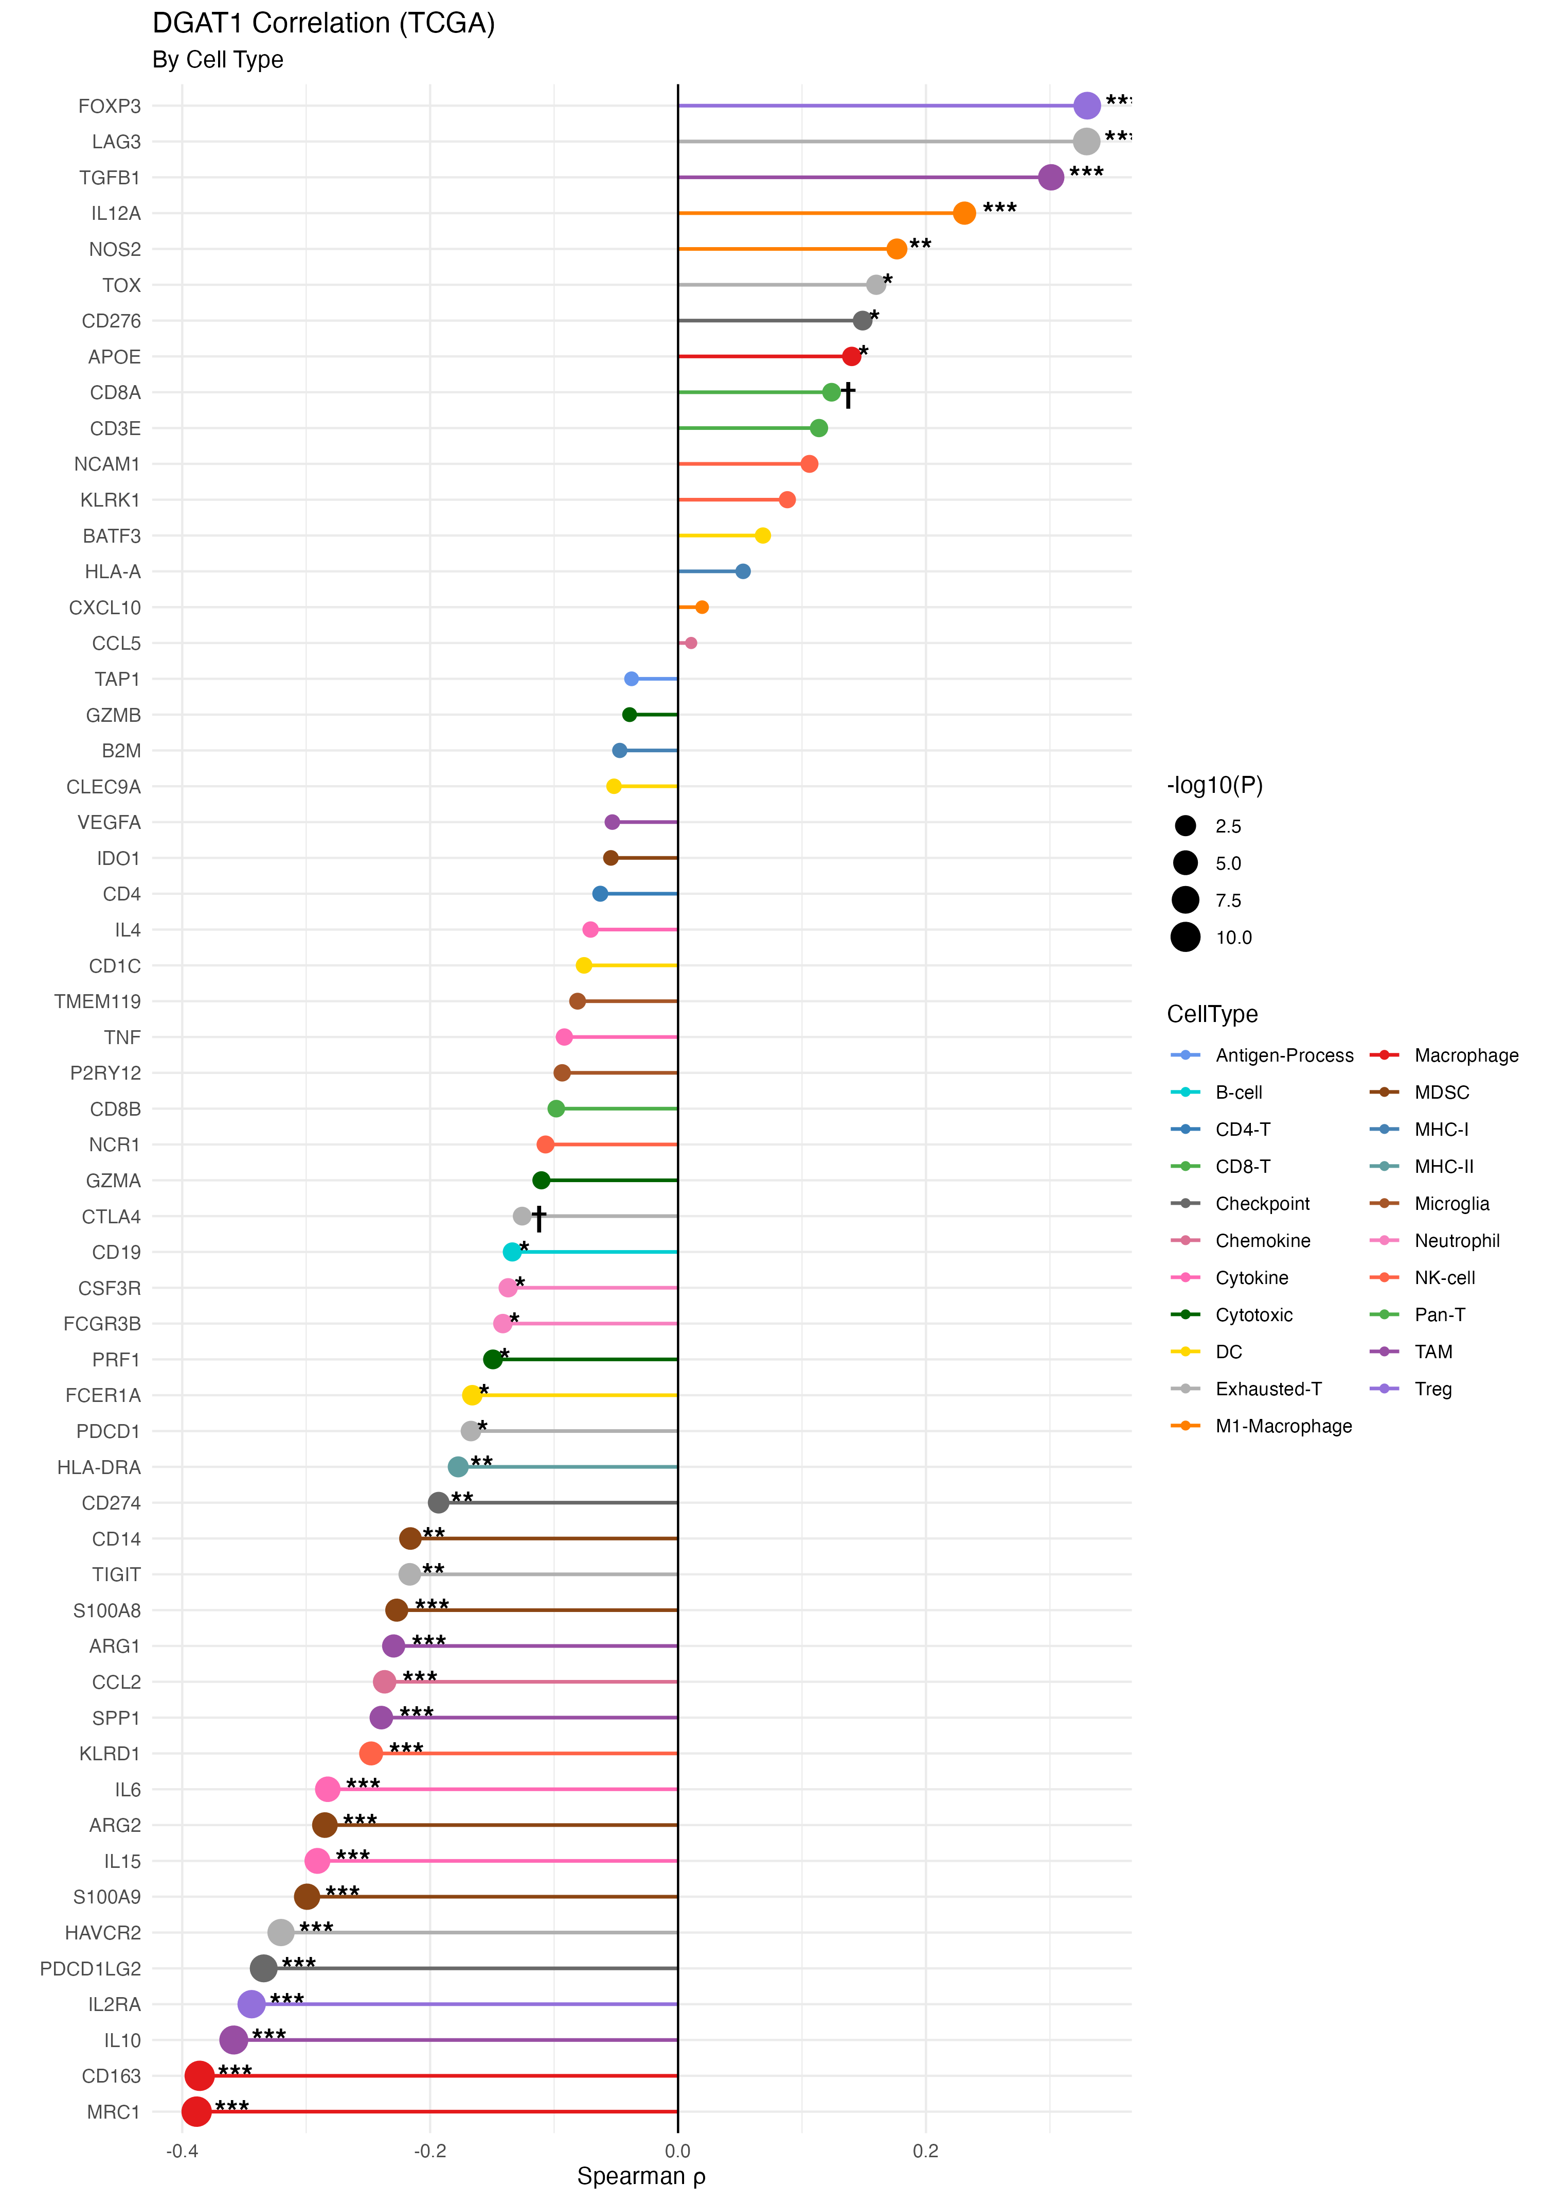
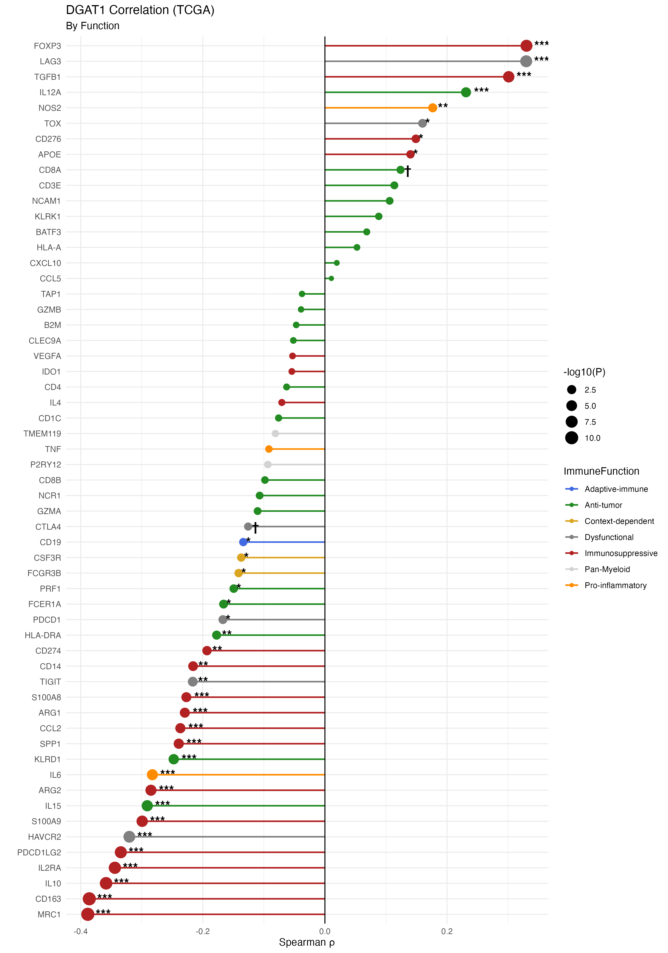
20250930
Strongest negative (left, **):
CD163, MRC1 (M2 macrophages)
IL10 (TAM suppression)
IL2RA (Treg activation)
PDCD1LG2 (PD-L2 checkpoint)
Strongest positive (right, **):
FOXP3 (Treg master TF)
LAG3 (T cell exhaustion)
TGFB1 (TAM cytokine)

Slide 9
20250930
DGAT1 expression inversely correlates with M2 macrophage and TAM immunosuppressive markers (33/57 markers FDR < 0.05), suggesting DGAT1-high GBM tumors may have reduced myeloid-mediated immunosuppression

Slide 10
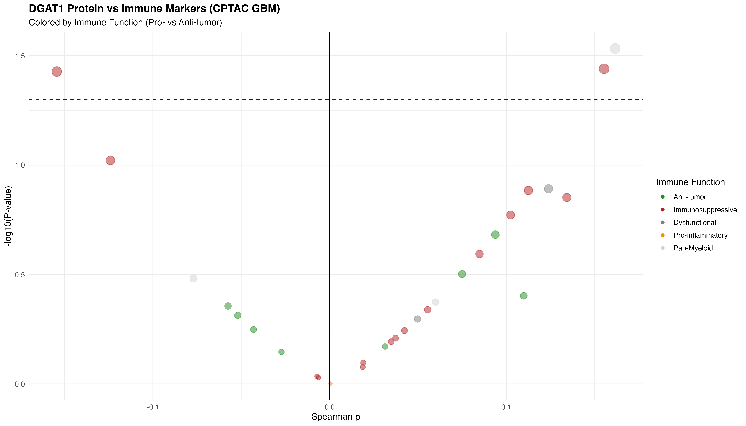
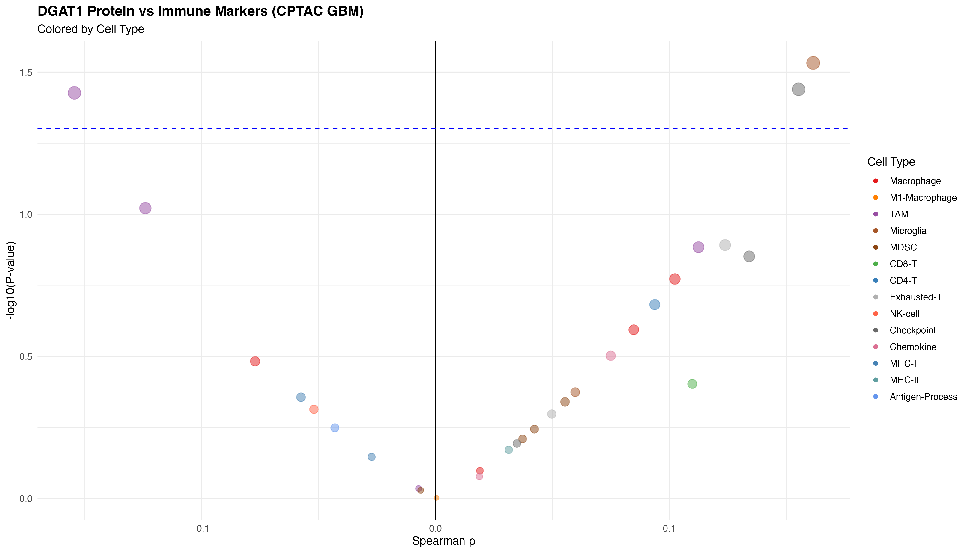
20250930

Slide 11
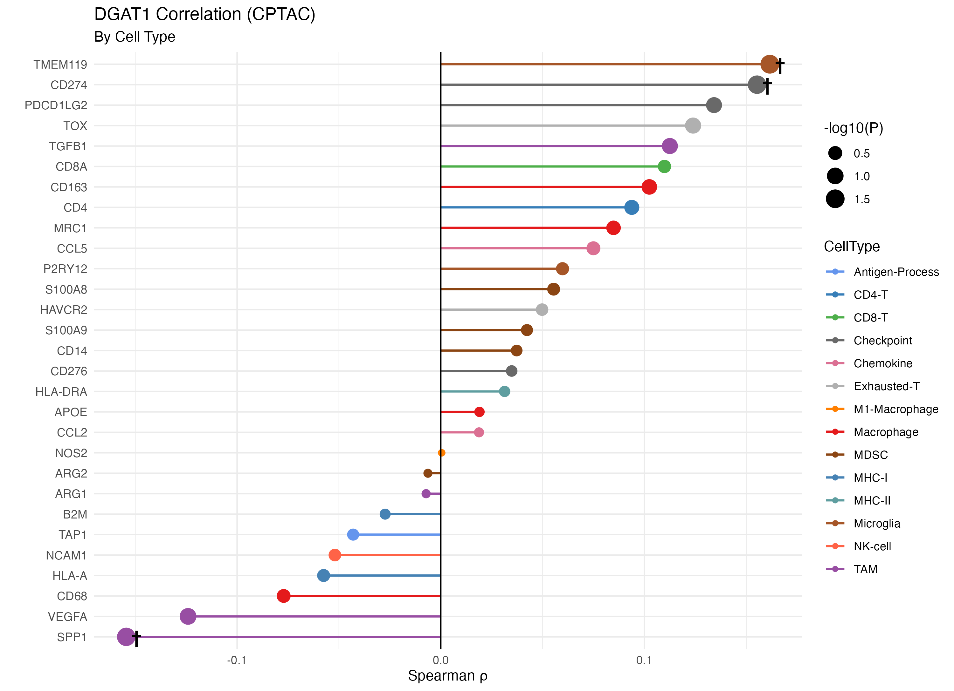
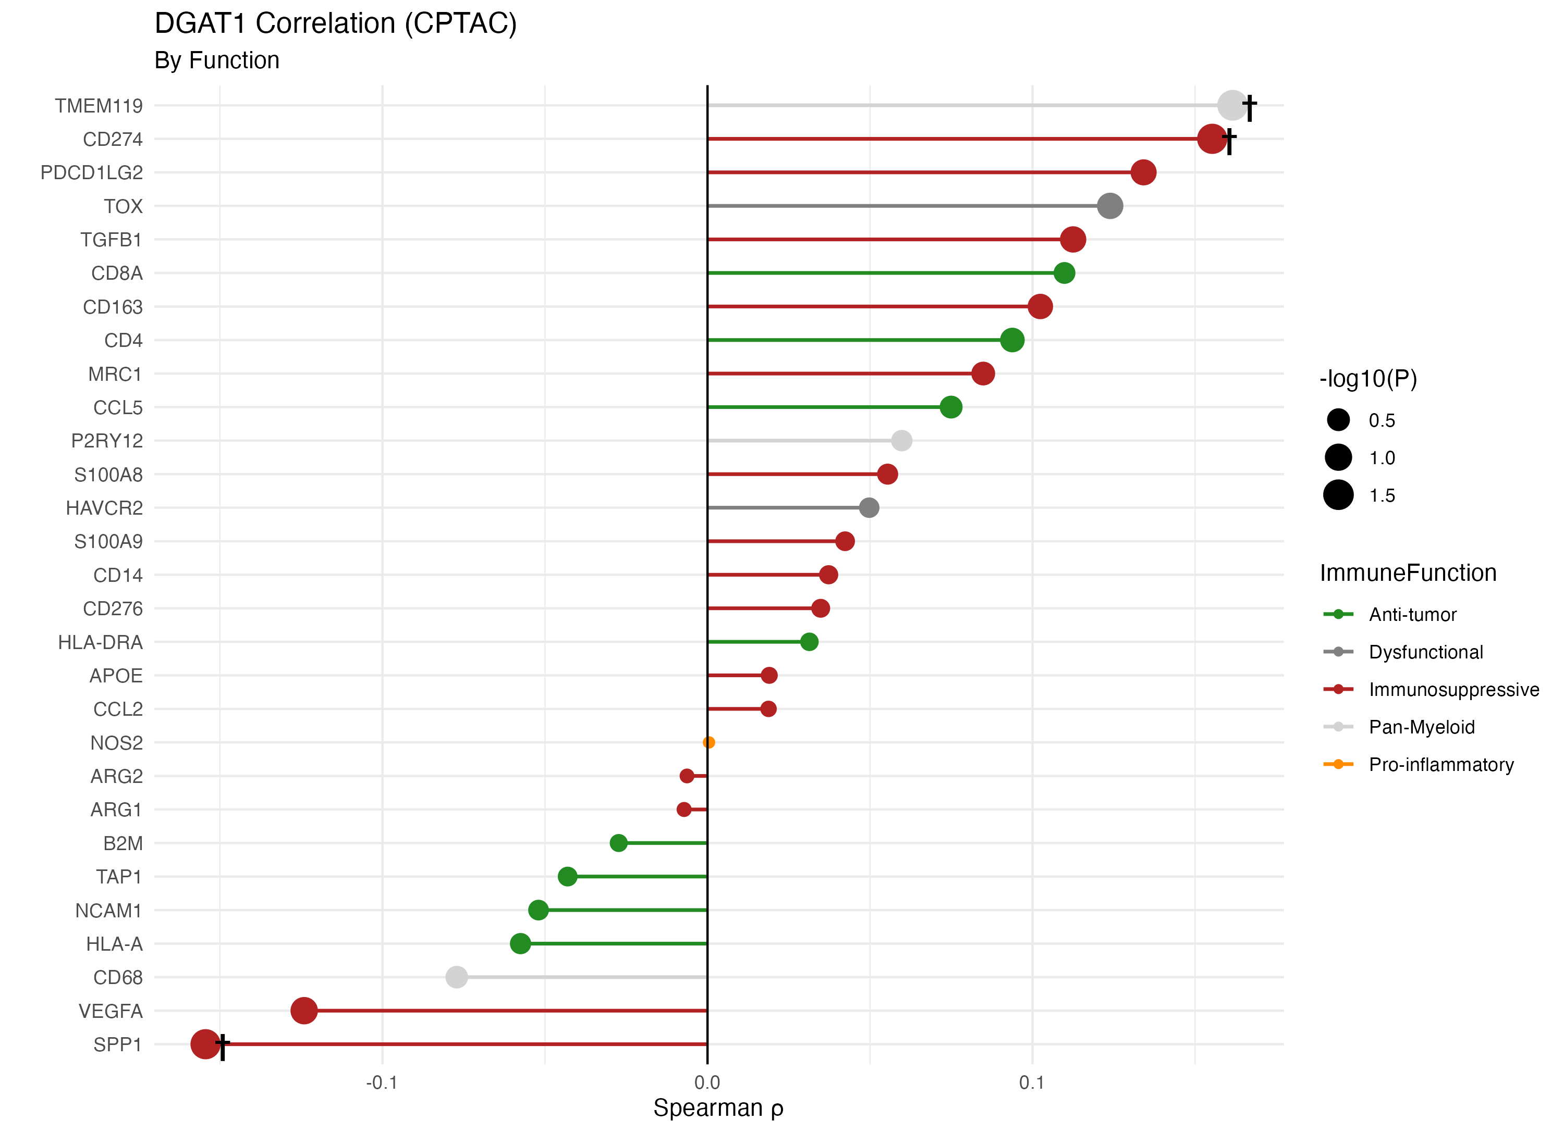
Opposite trends:
TCGA: CD163, MRC1 strongly negative (ρ ≈ -0.39)
CPTAC: CD163, MRC1 weakly positive (ρ ≈ +0.10)
Possible explanations:
Post-translational regulation differences
Limited proteomics sensitivity for immune proteins
Different patient cohorts
20250930

Slide 12
Cross-Platform Comparison Box:
Feature | TCGA (mRNA) | CPTAC (Protein)
Coverage | 93.4% | 47.5%
Significant | 33 markers | 0 markers
Top correlation | CD163 (ρ=-0.39) | TMEM119 (ρ=+0.16)
M2 pattern | Strong negative | Weak positive

Slide 13
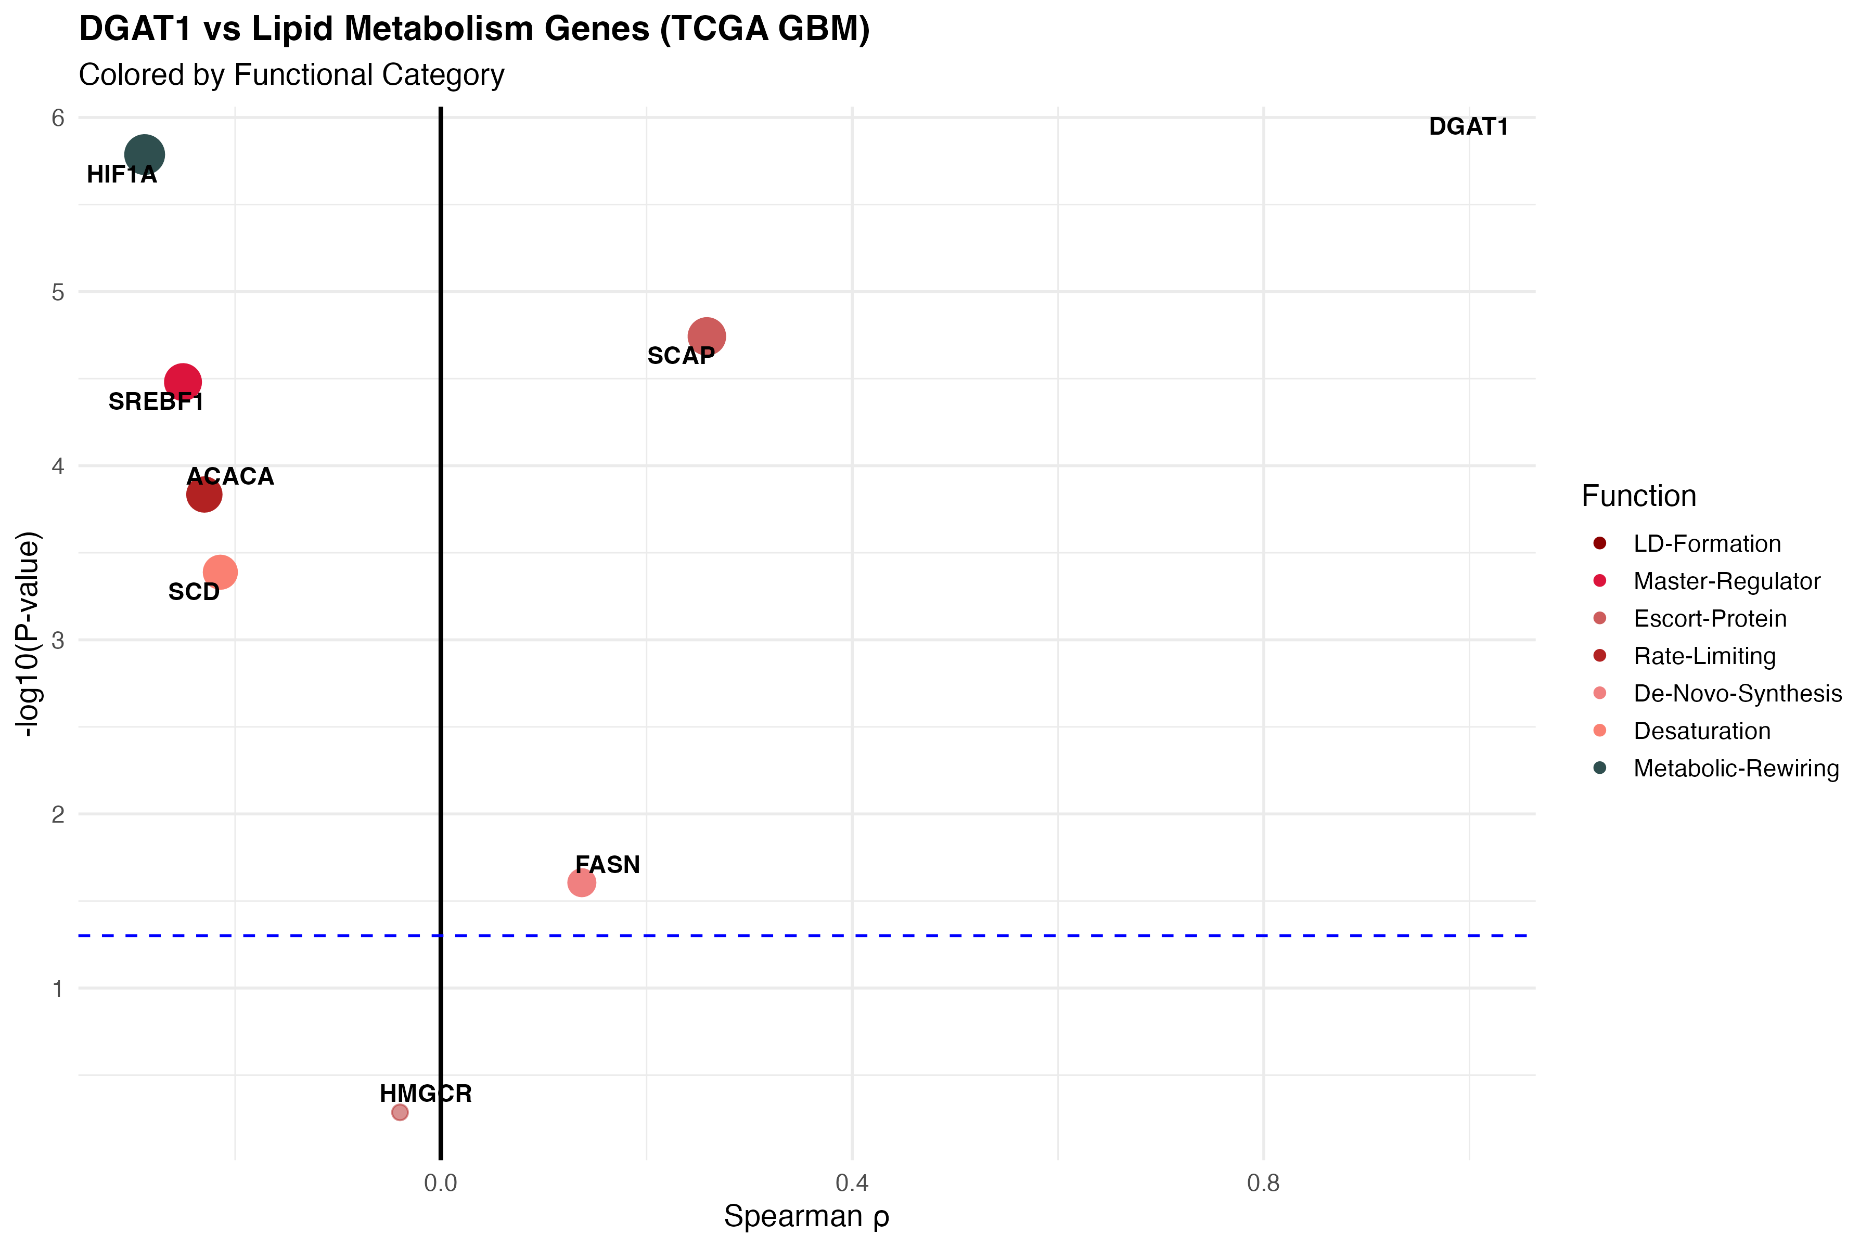
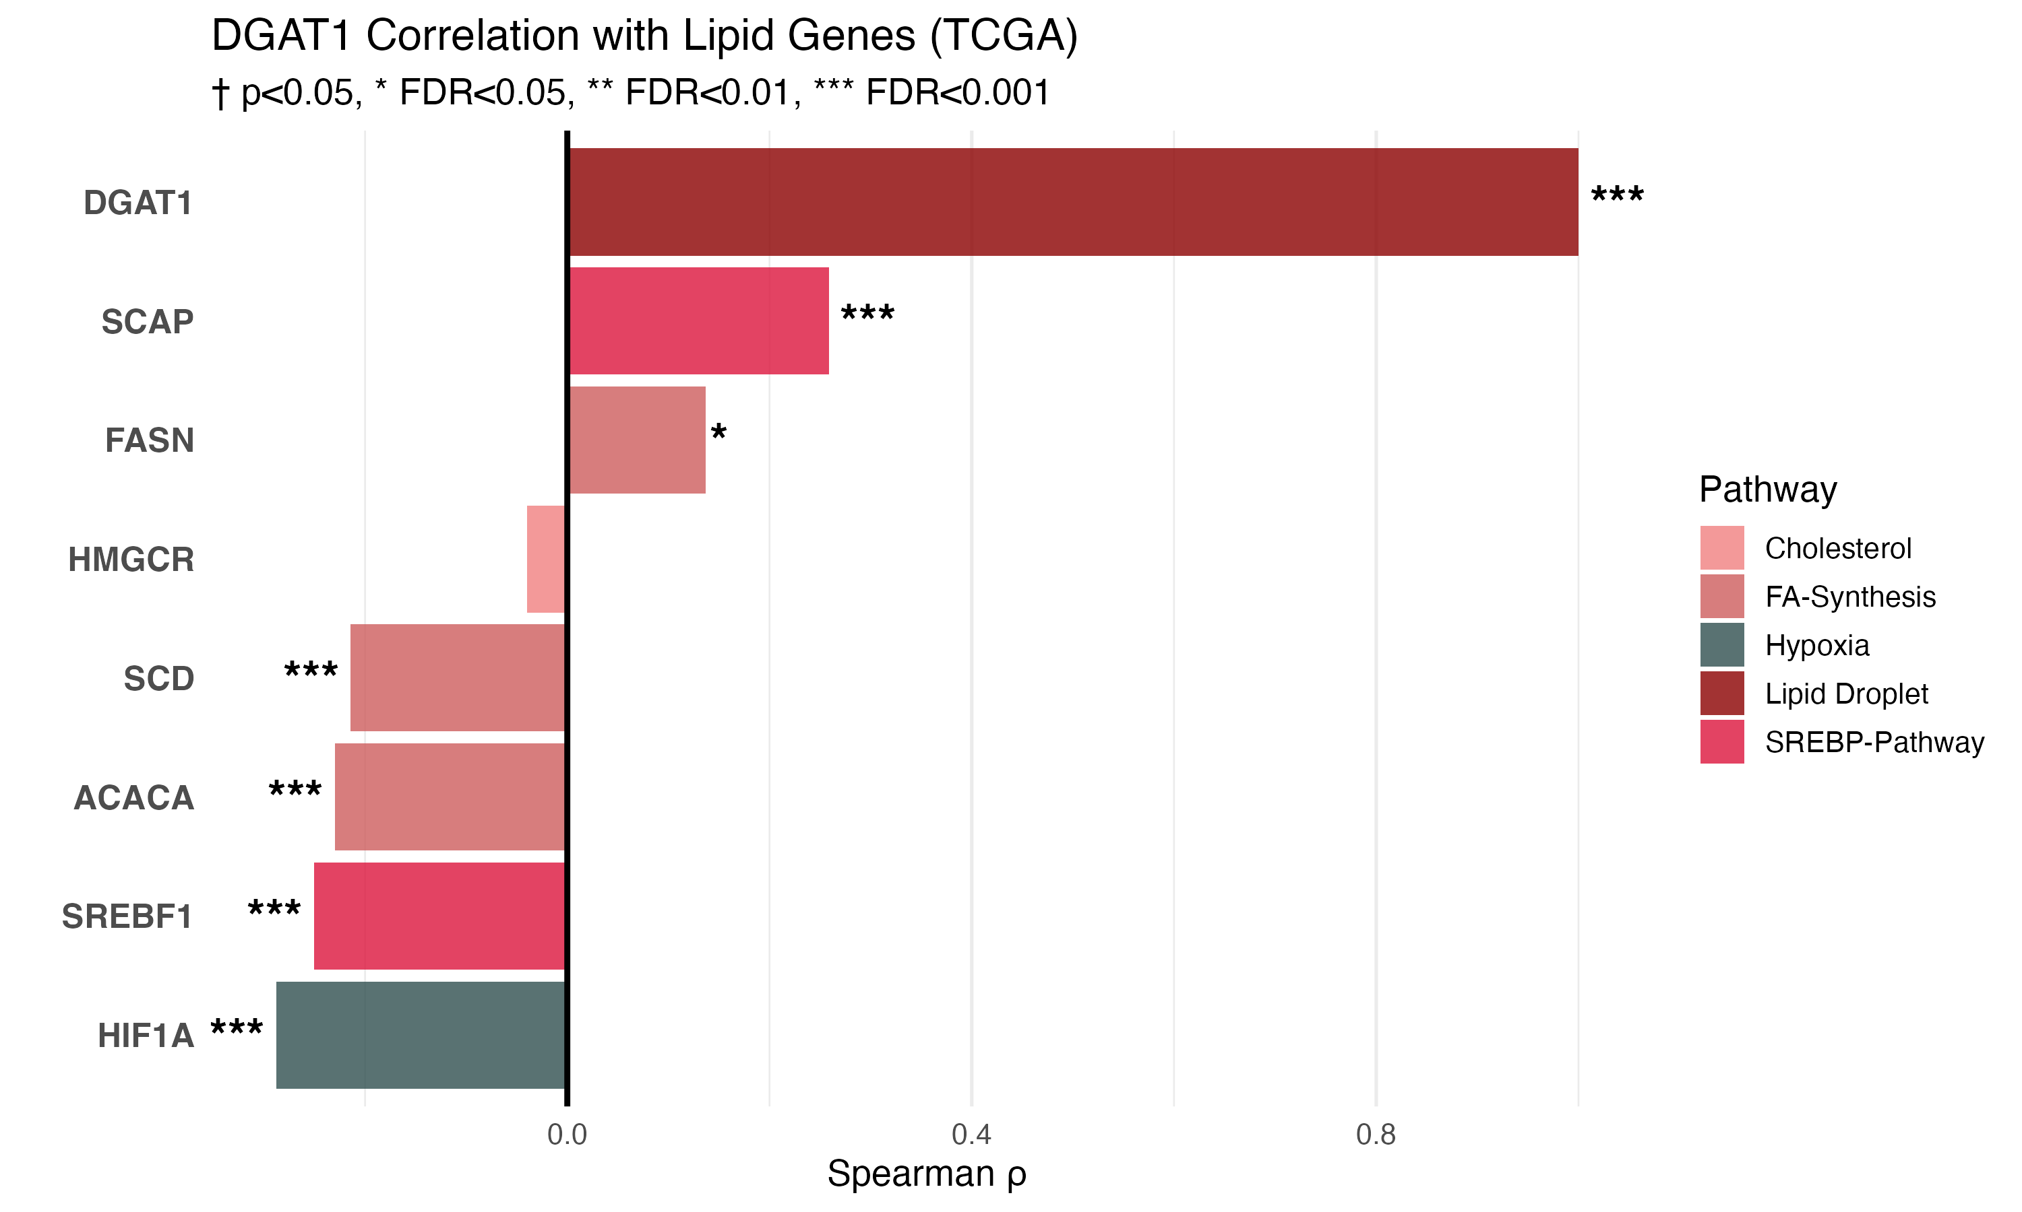

Slide 14
Future Directions – DGAT1 in GBM (Metabolism–Immune Axis)
Analysis
Subtype & scRNA-seq → tumor vs TAM compartment
Integrate mRNA & proteomics (TCGA vs CPTAC)
GSVA: lipid metabolism ↔ immune suppression pathways
Experimental Validation
In vitro:
DGAT1 KO in GBM→ LDs & cytokines
In vivo:
Implant DGAT1-KO tumors → test immune infiltration (CD8, Tregs, TAMs)
Use Cx3cr1-CreER / Tmem119-CreER for inducible DGAT1 KO in macrophages & microglia
± DGAT1 inhibitor → rescue/phenocopy check

Slide 15
Thanks!

Slide 16
Only two papers provide robust experimental evidence that DGAT1 drives immunosuppressive TAMs: Wu et al. 2019 offers the strongest mechanistic proof in colon cancer models, PubMed Centralnih while He et al. 2021 provides clinical validation in gastric cancer patients. PubMed Central +5 Claims that "DGAT1 inhibition increases CD8+ infiltration" are not supported by current literature—in fact, the opposite was observed. nihPubMed Central The relationship between DGAT1 and tumor immunity centers almost exclusively on macrophages, Nature +2 leaving T cell biology unexplored. This represents both a significant limitation of current knowledge and an opportunity for future investigation.

Slide 17
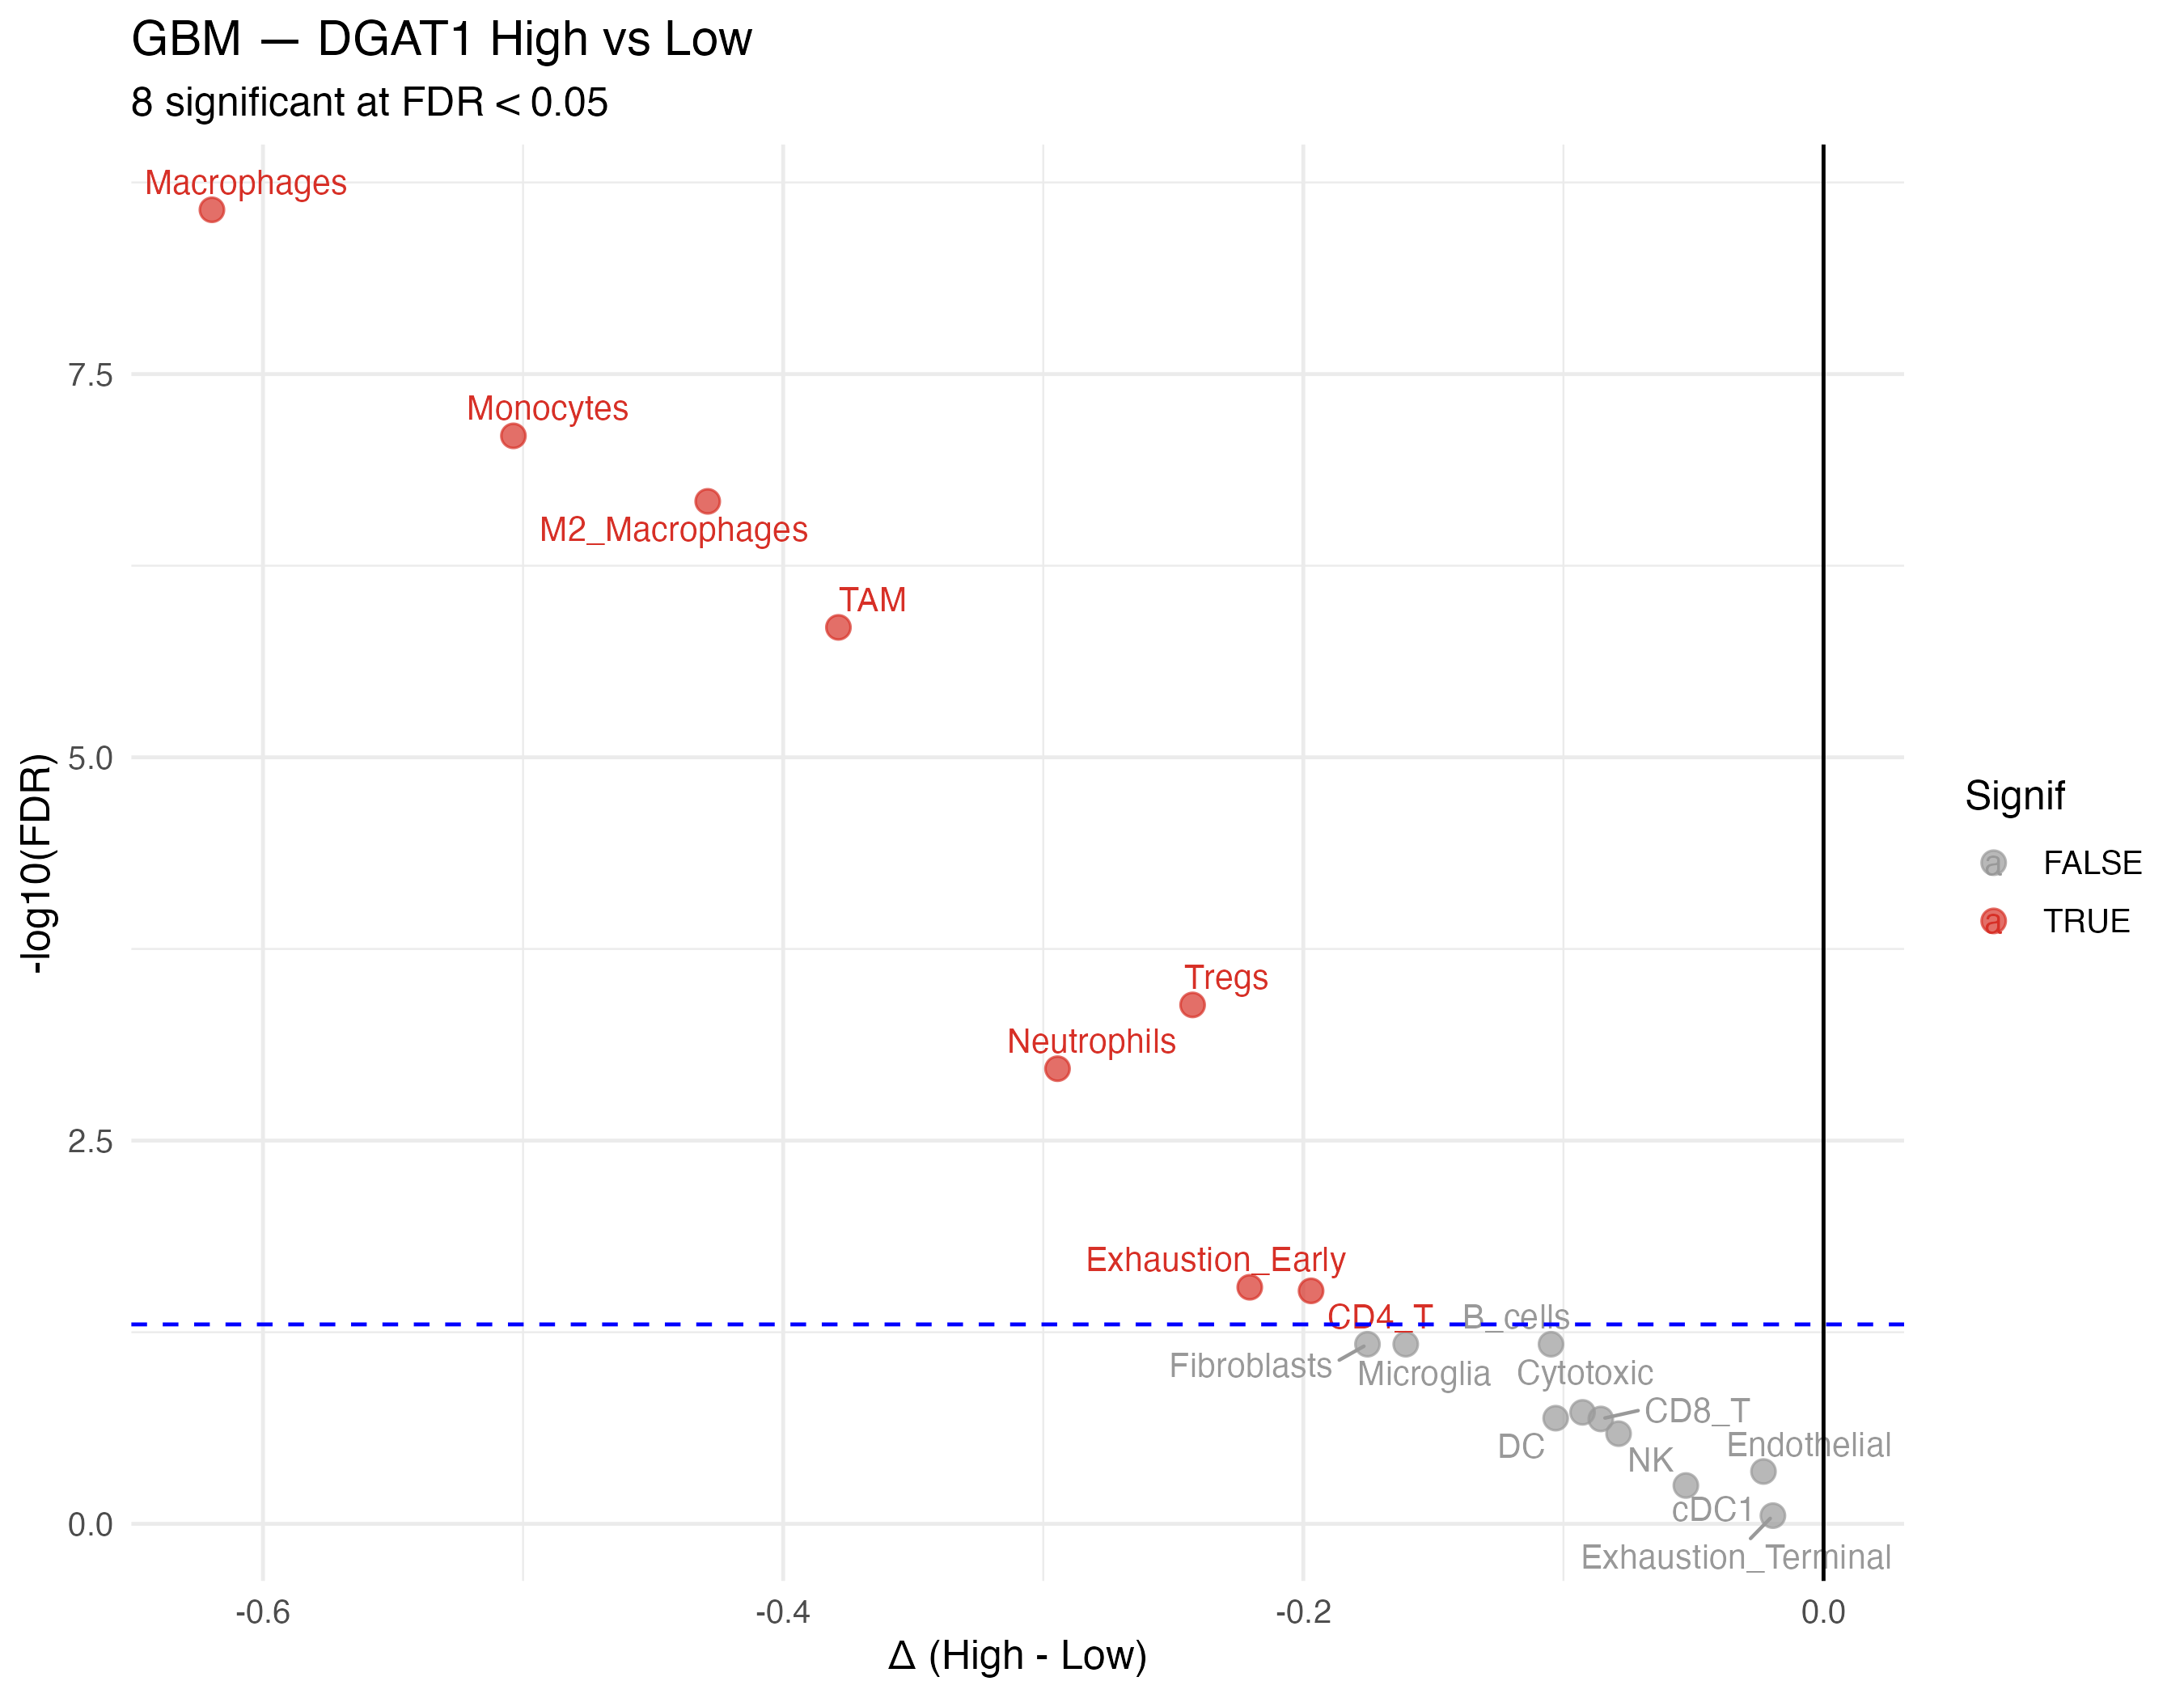
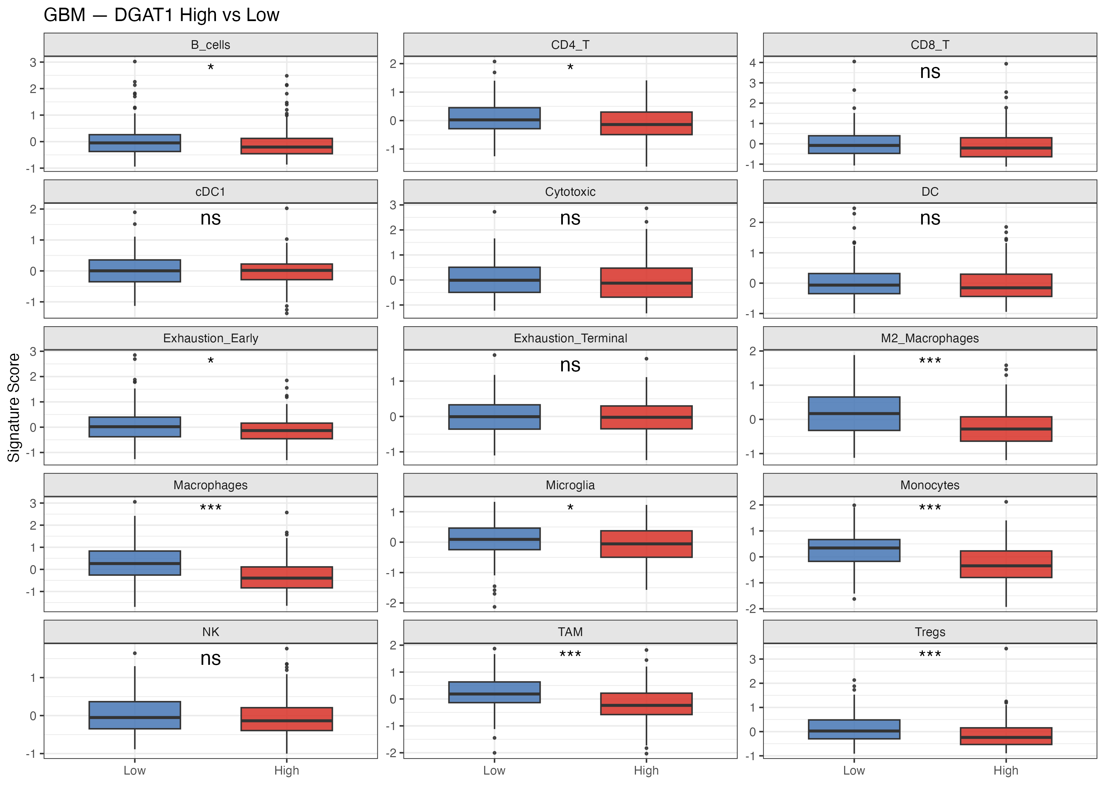

Slide 18
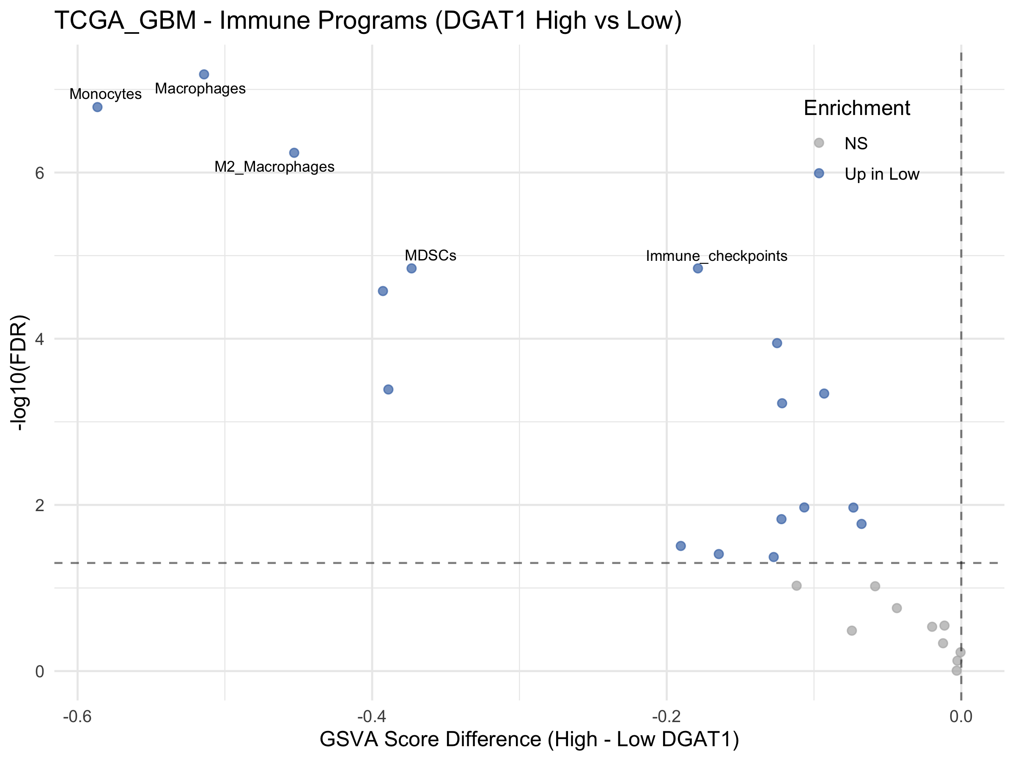
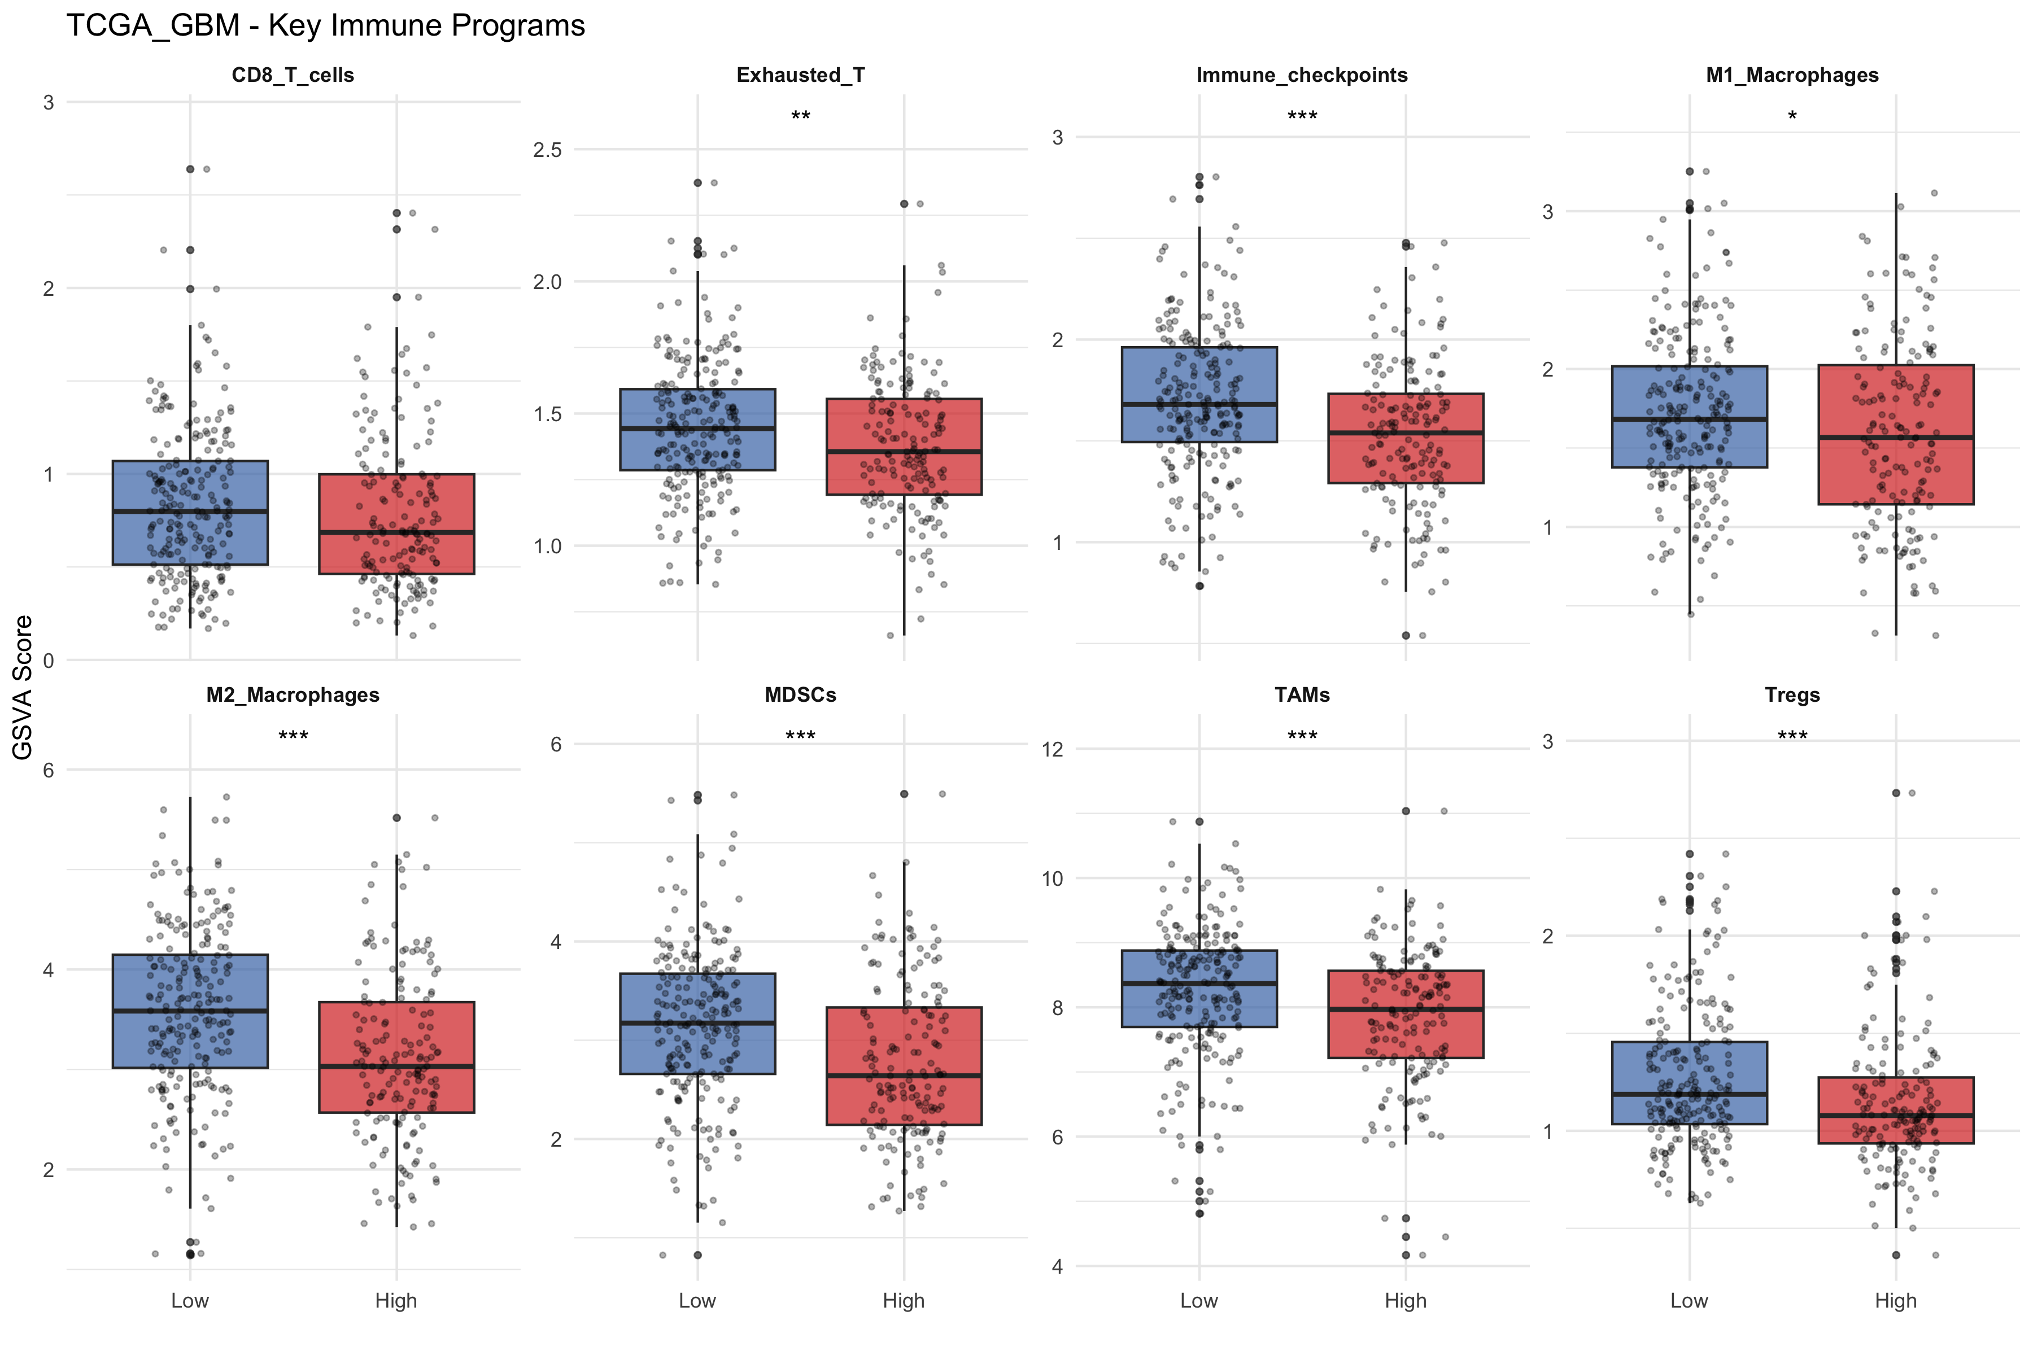

Slide 19
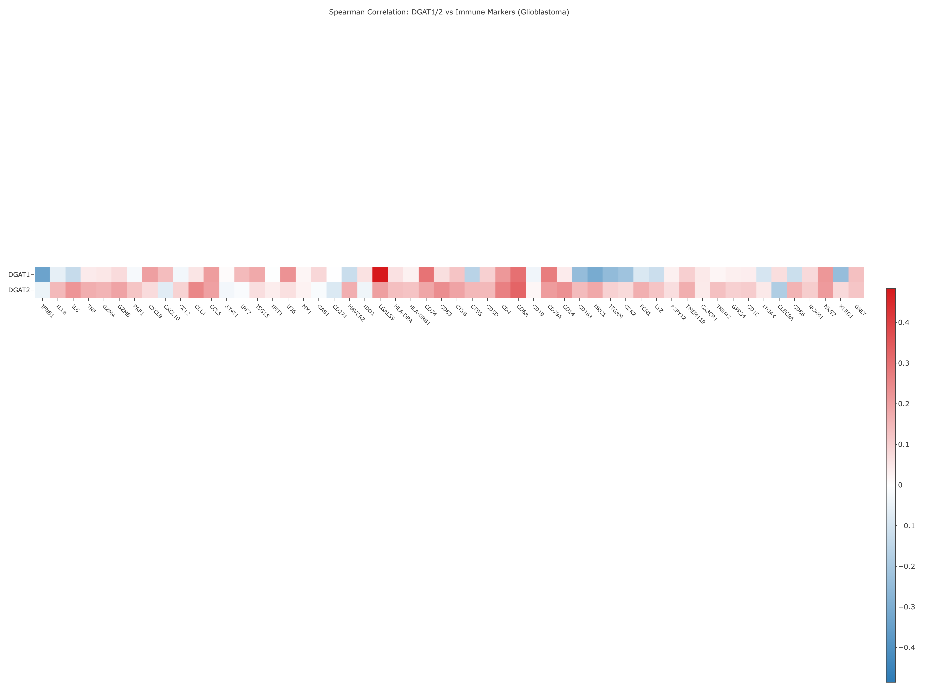
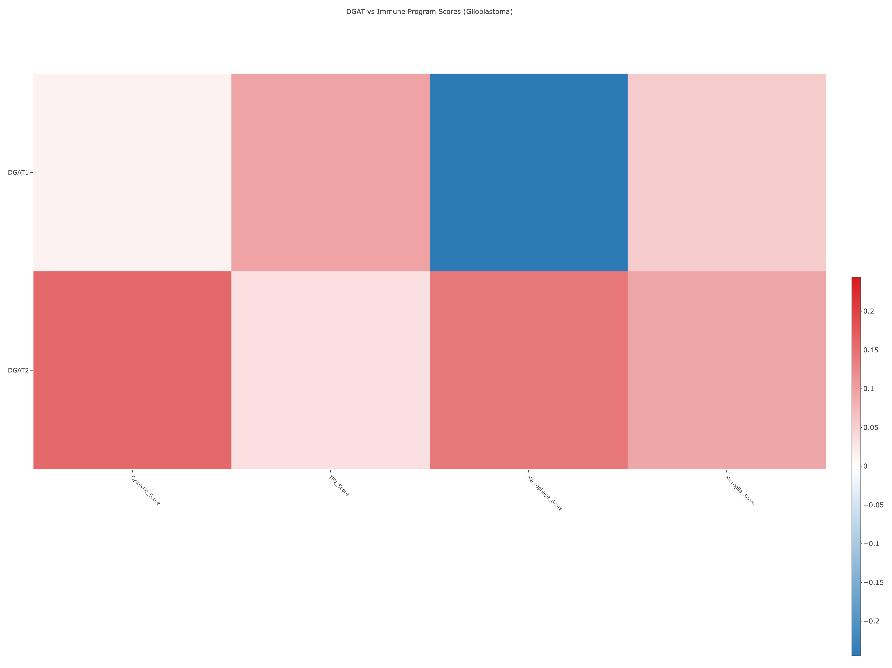
20250929

Slide 20
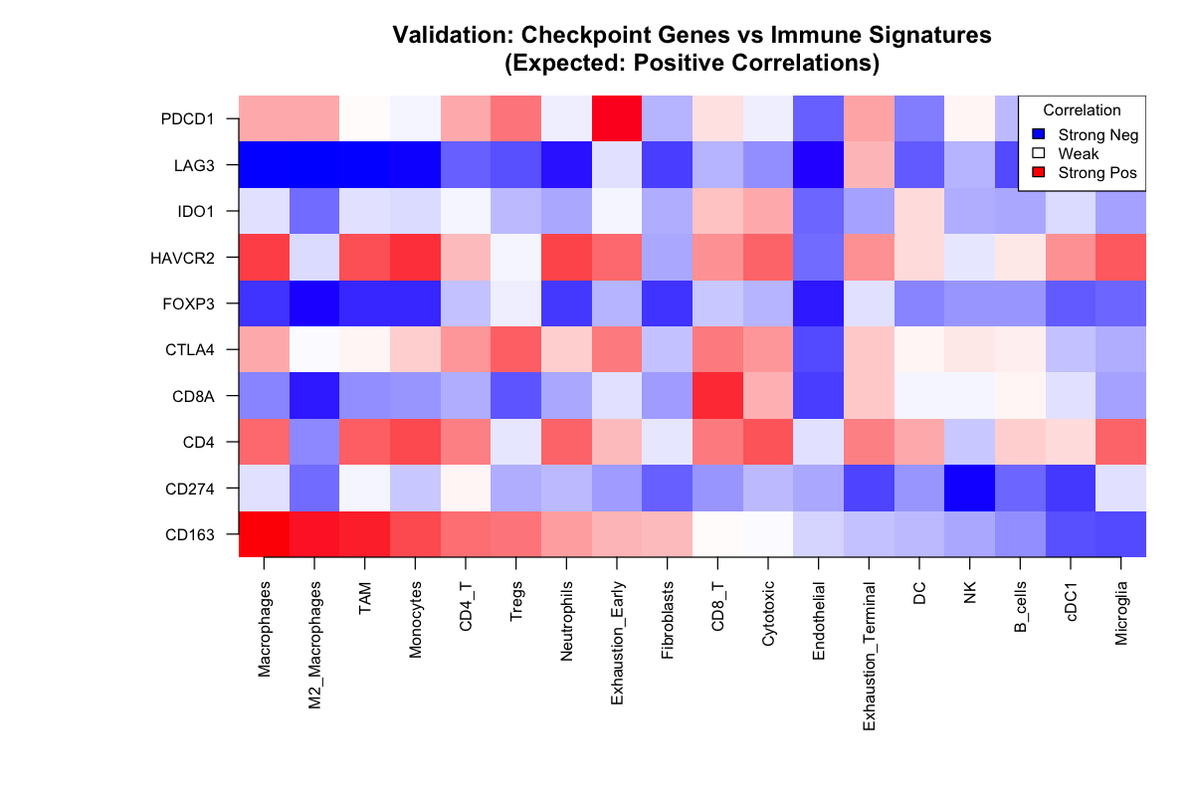

Slide 21
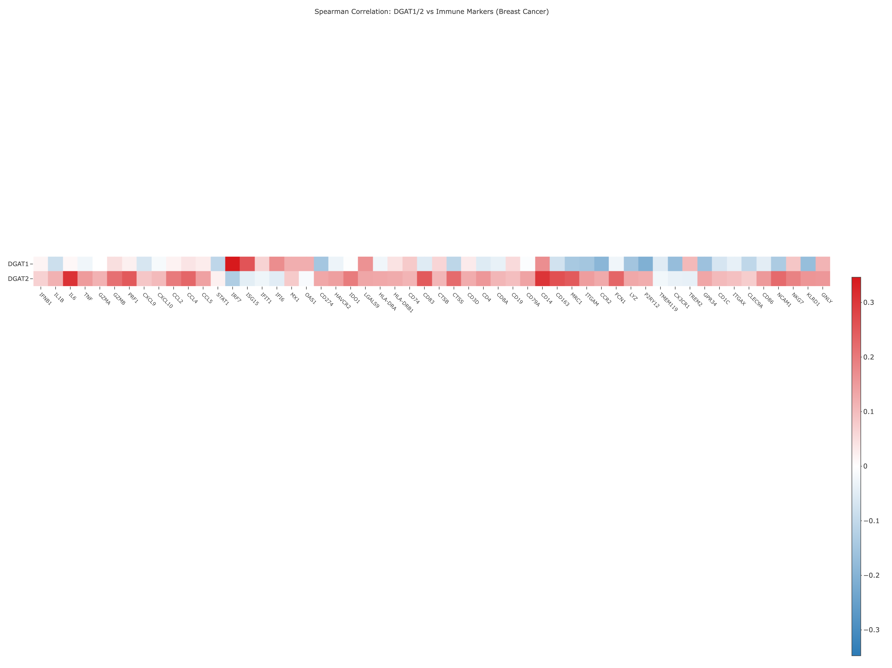
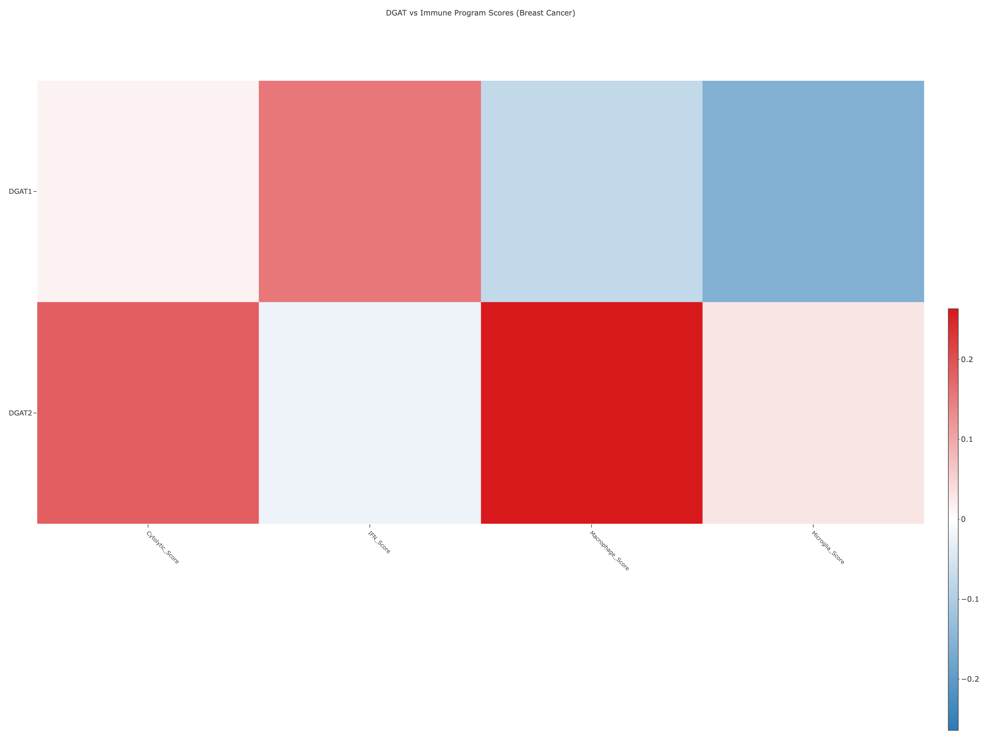
20250929

Slide 22
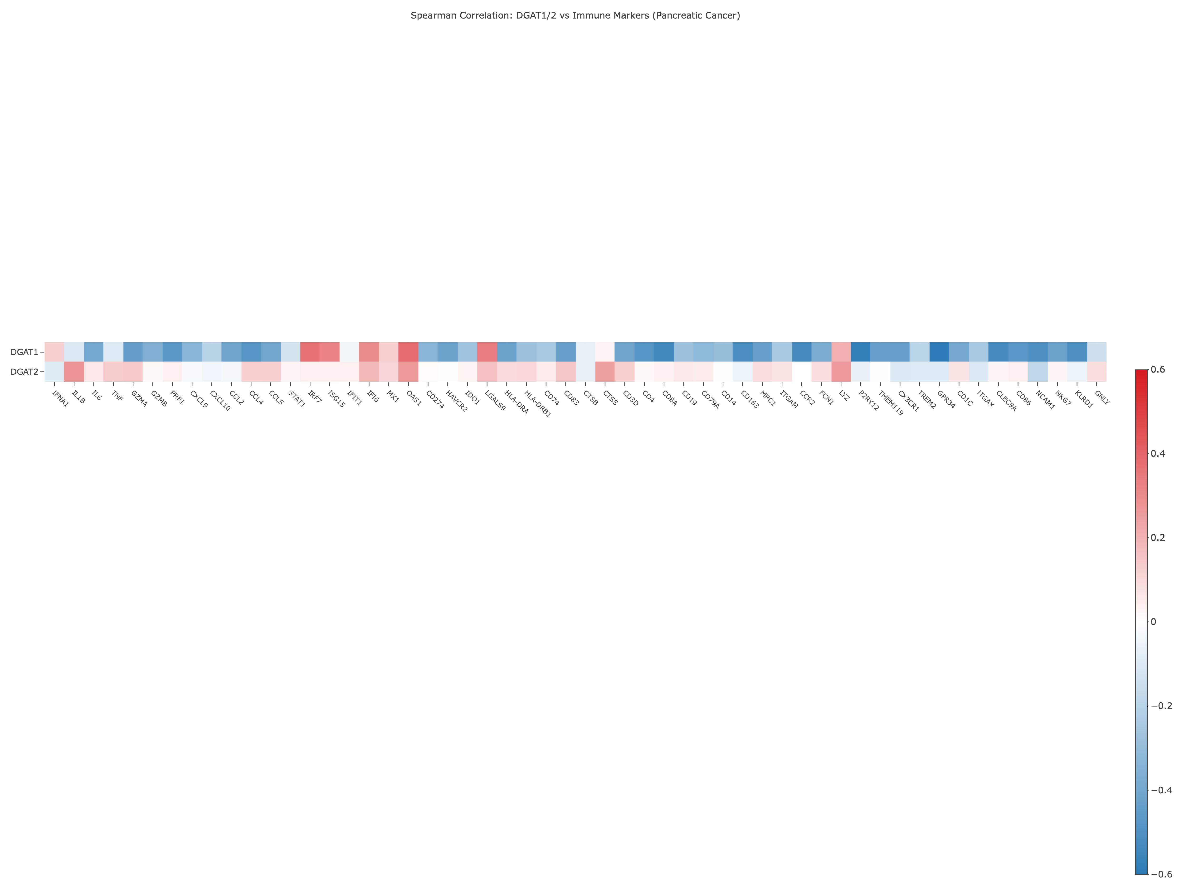
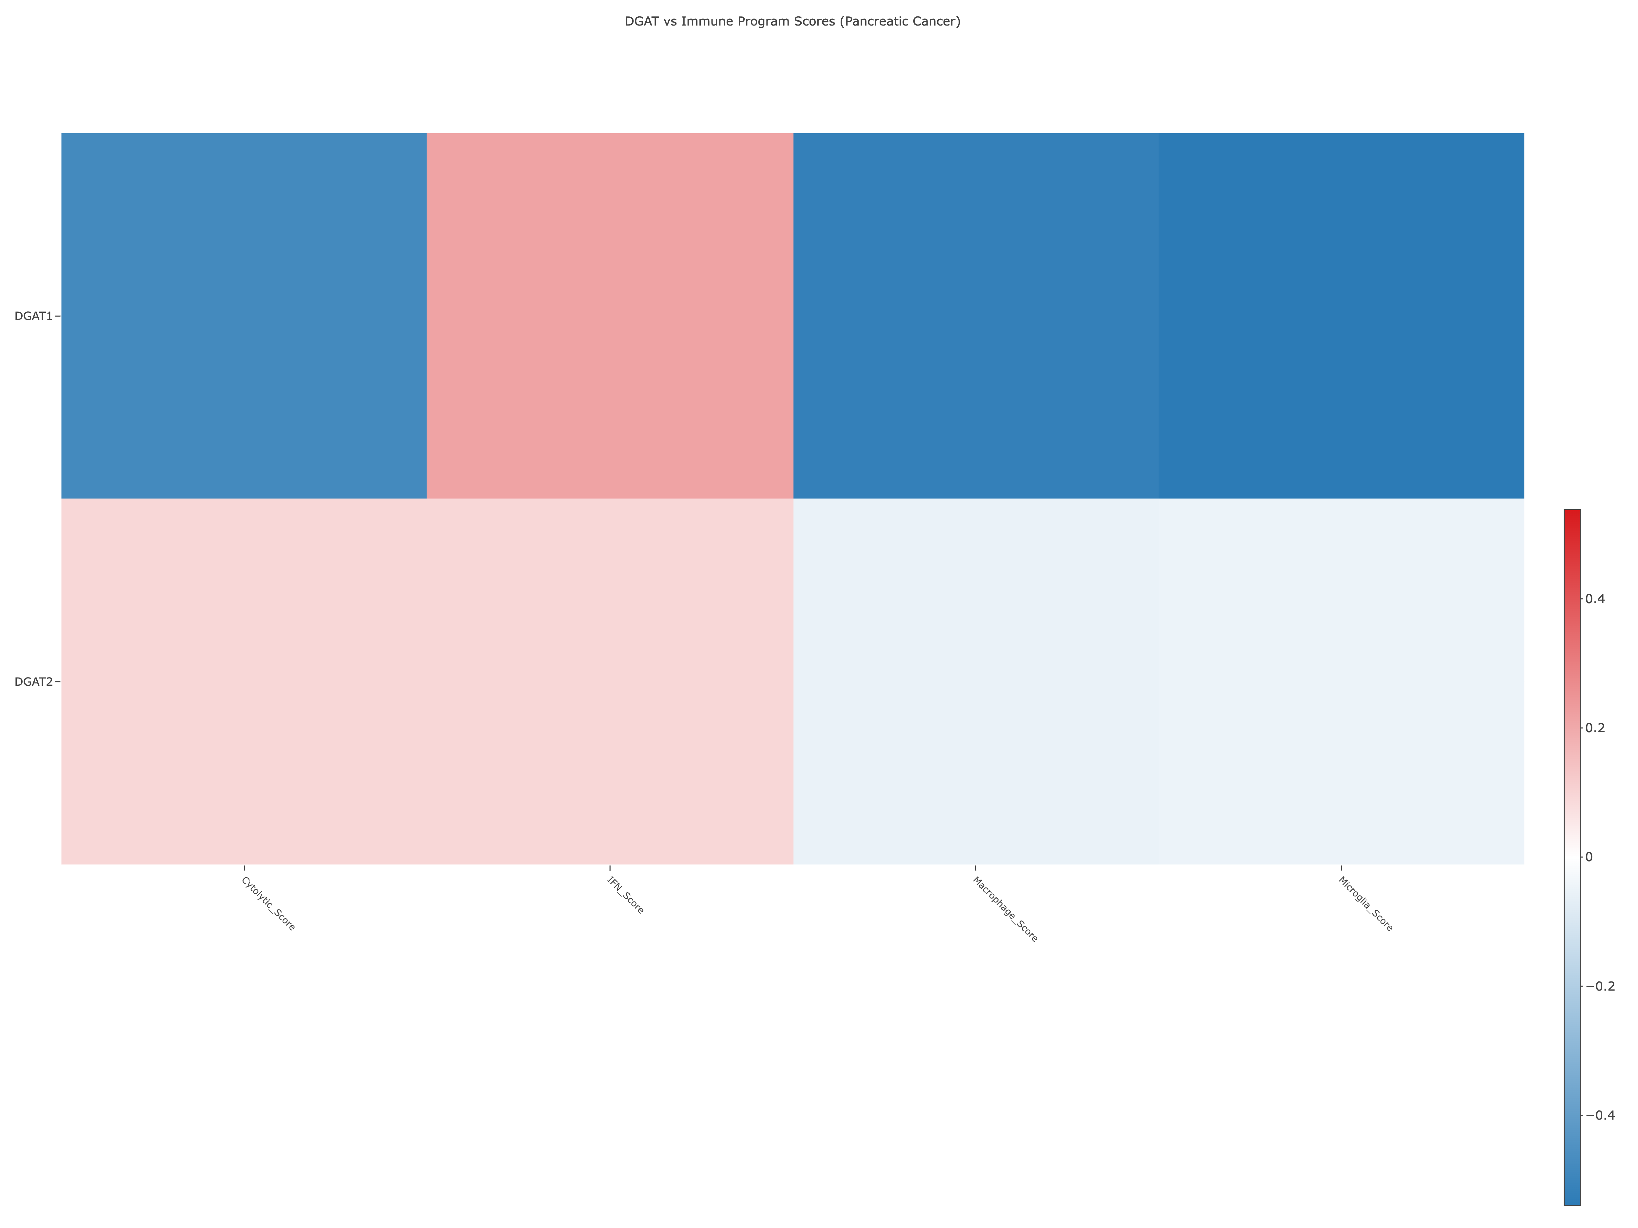
20250929

Slide 23
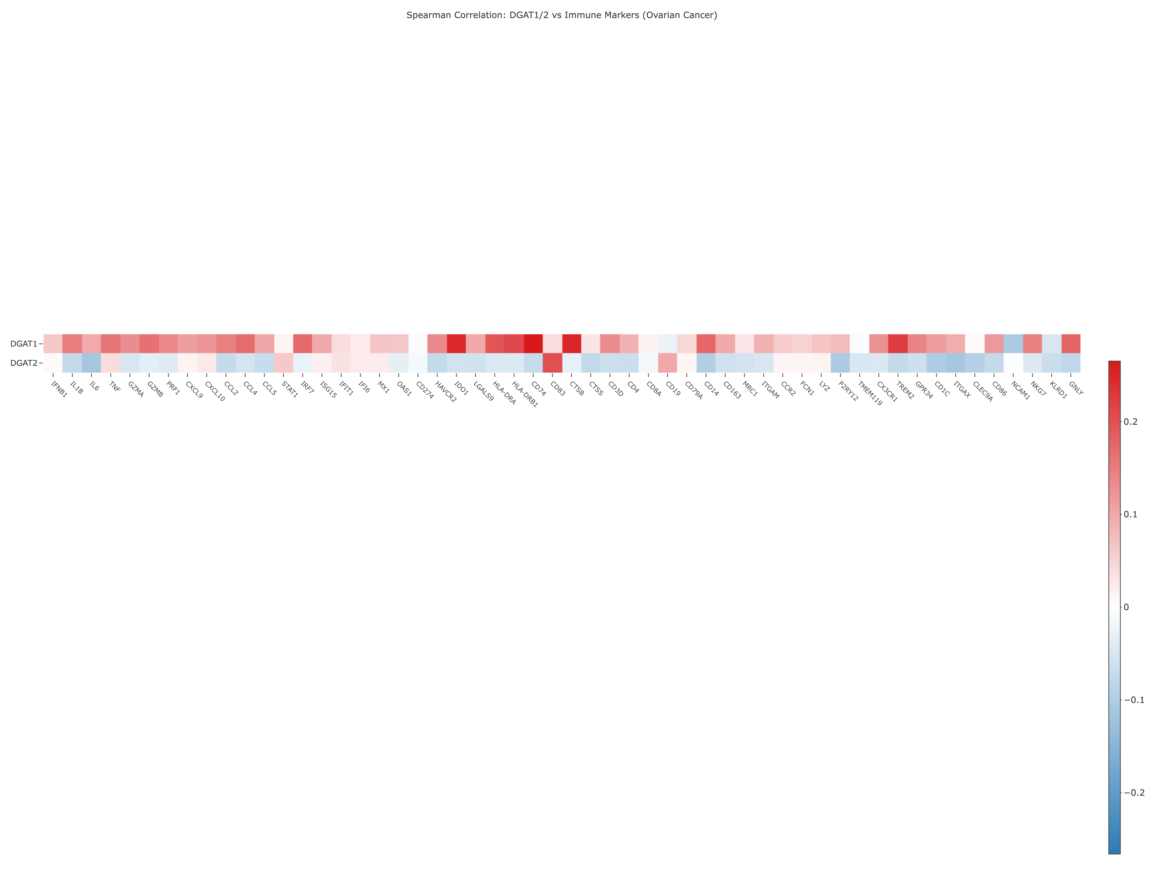
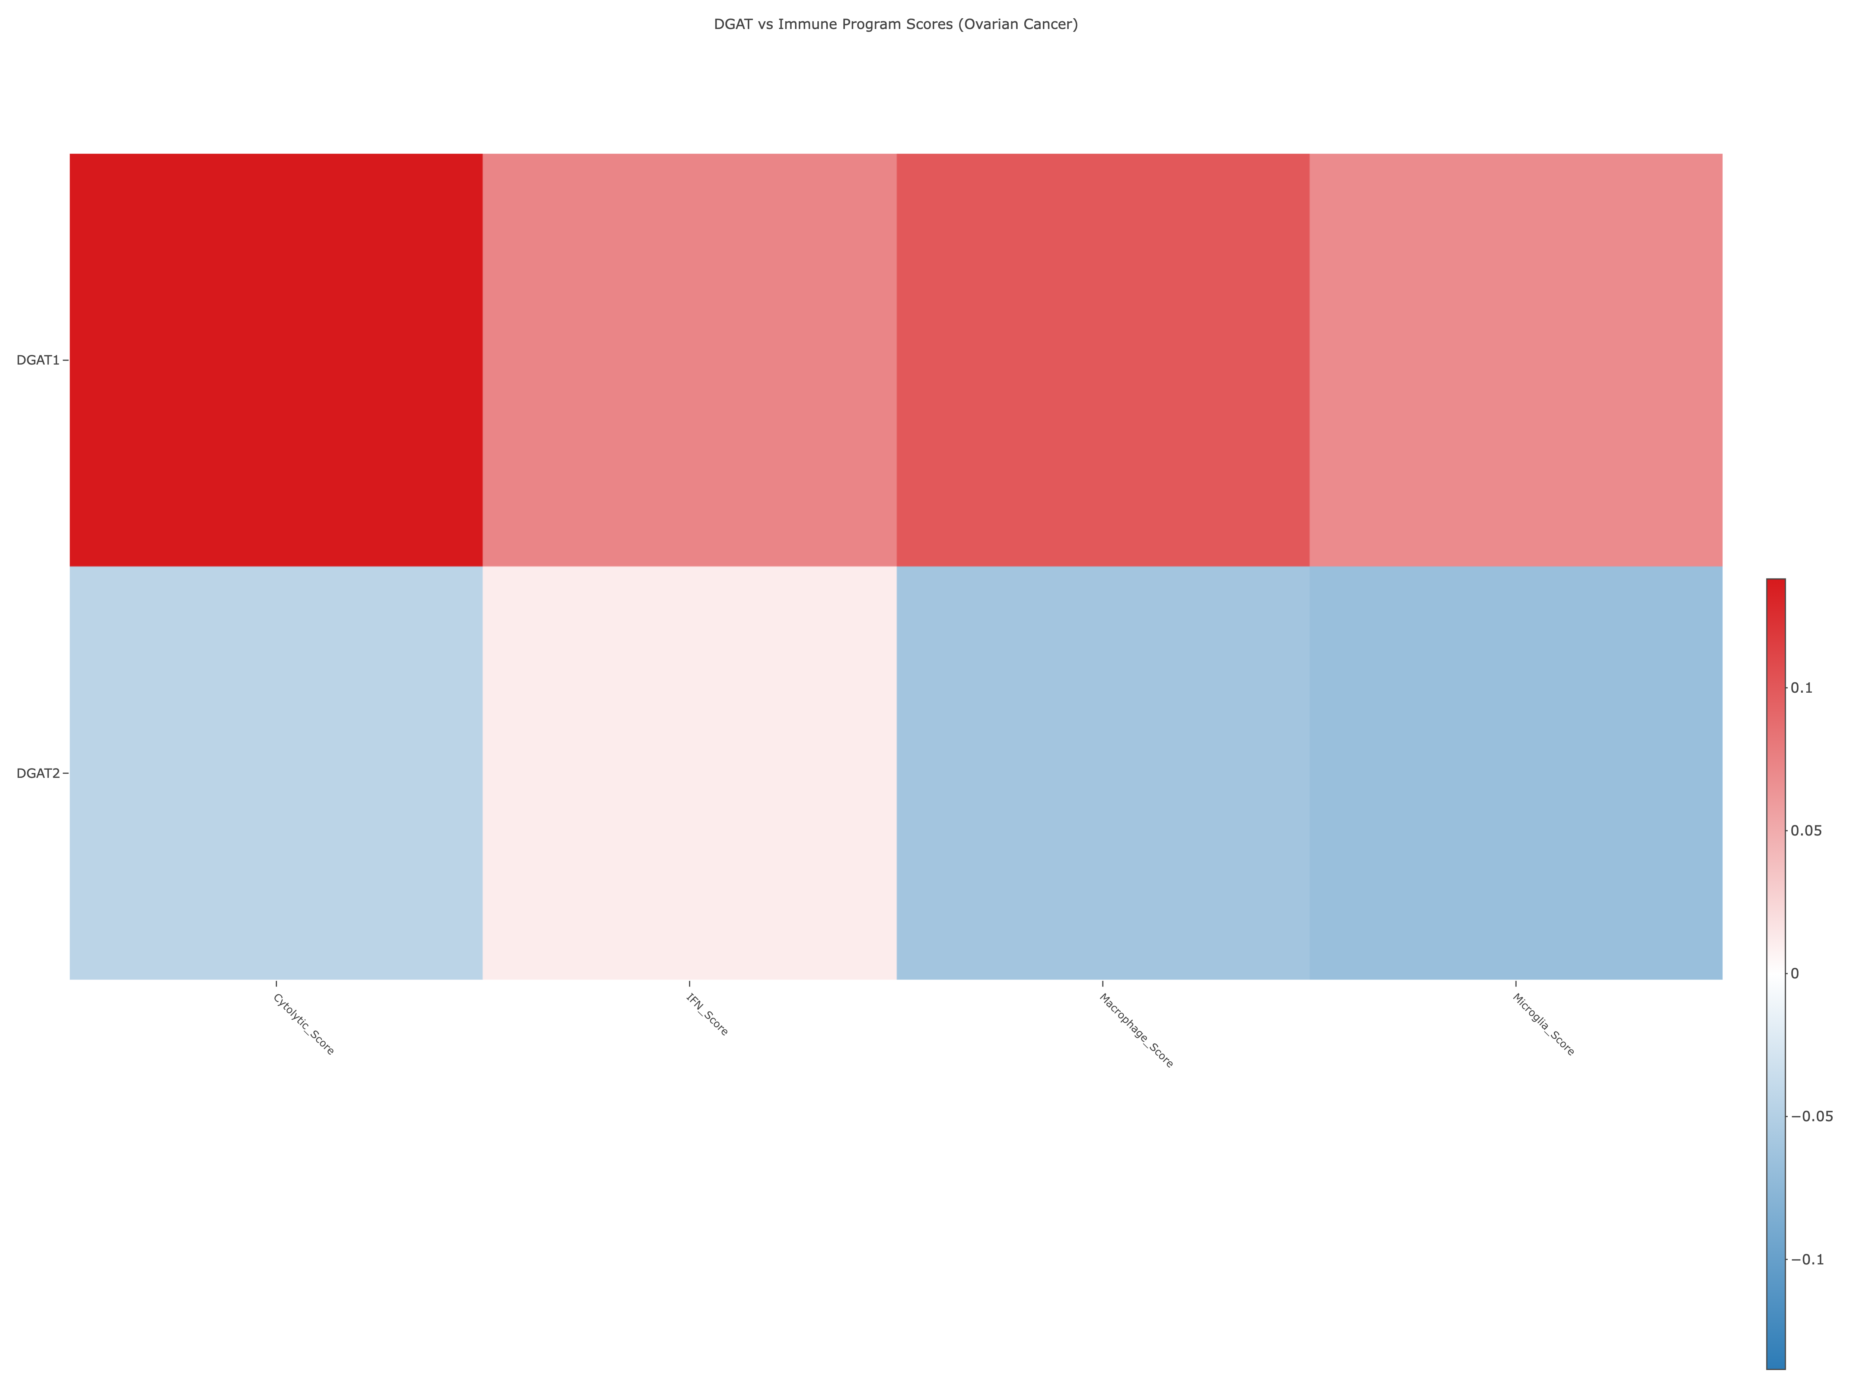
20250929

Slide 24
